Slide 1
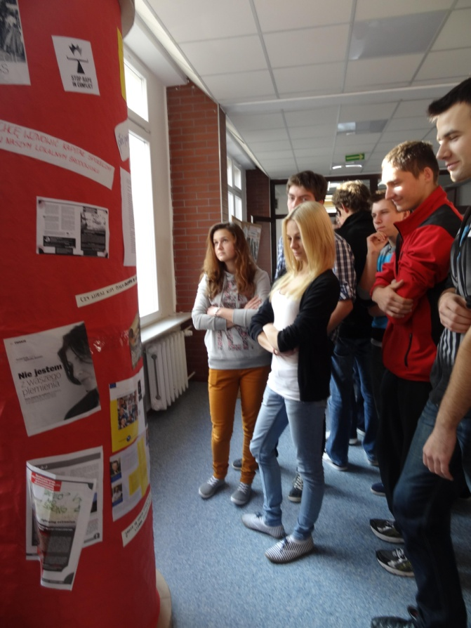
Comenius Project School Factory of Initiatives-equal citizenship
Stefan Żeromski High School Żyrardów

Slide 2
The most important goals of the GENDER Campaign
Raising the awareness of the need to respect the idea of ​​gender equality.
Dissemination of knowledge about human rights, with particular emphasis on the rights of women / girls in Poland.
Enhancing critical attitude towards pressure of gender role stereotypes in different areas of life and also raising awareness against violence and all forms of discrimination.

Slide 3
Strategies of the GENDER Campaign
The offer to participate is directed to all the students interested in the topic.
It is undertaken in collaboration with several organizations who support education for anti-discrimination attitudes – an example of a modern way of enriching the school resources.
It aims to acquire knowledge on gender and to develop skills related to the use of this perspective.
It is to discourage promotion of participation of women / girls in social, economic and political life.

Slide 4
Gender Campaign Tasks
Preparing a school magazine;
Participation in lessons on gender issues (biology classes and weekly form periods);
Poster campaign;
Interviewing NGOs activists dealing with anti-discrimination education;
Publishing articles on the school website and in the local press;
Carrying out surveys on the level of interest in gender issues and the level of understanding of the impact of gender on the lives of people in different areas;
Taking part in a lecture by Agnieszka Sznajder on equal opportunities for women and men in the labour market
Taking part in workshops conducted by Agnieszka Sznajder entitled Socio-cultural gender and its impact on life choices.

Slide 5
Interviews on the role of gender in society
With Ewa Rutkowska - a graduate from the UW (in philosophy) and from the School of Social Sciences (Polish Academy of Sciences), a co-author of a guide for teachers ’’Equal school - education free from discrimination’’ and of reports on violence against women and on Gender Mainstreaming in Polish education, prepared for the Feminoteka Foundation and H.Boell Foundation;
With Agnieszka Sznajder – an educator from the Anti-discrimination Education Society;
With a coach Marta Siciarek – an anti-discrimination instructor, a graduate from Willa Decjusza

Slide 6
The objectives and content of Agnieszka Sznajder’s lecture
Objective:
Explaining the principle of equal opportunities for men and women.
Content of the lecture:
Myths and facts relating to the principle of equal opportunities.
Gender stereotypes: the stereotype of femininity and masculinity.
Discrimination in the labour market.
Gender Mainstreaming and the EU policy in the implementation of the principle of equal opportunities for women and men.

Slide 7
Anti-discrimination workshops on October 30th, 2012
Objective:
A reflection on the socio-cultural gender and its impact on career
choices and education of young people
The content of the workshops:
Biological sex and socio - cultural gender
Gender and the labour market;
Responding to discrimination resulting from gender stereotypes.

Slide 8
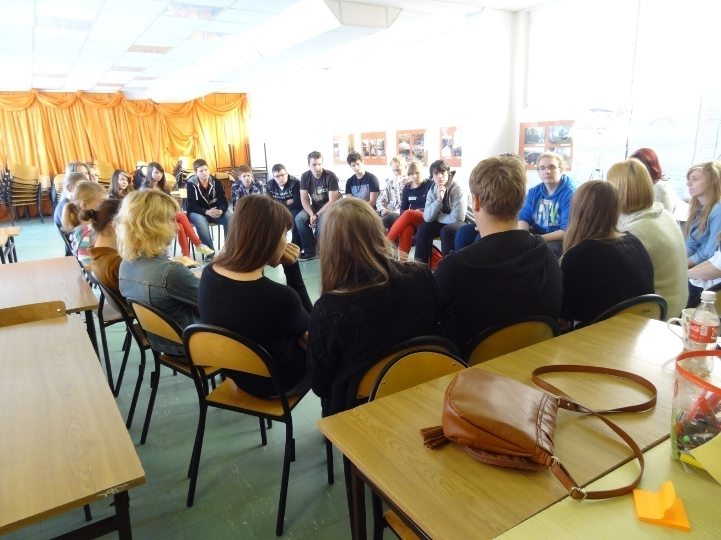
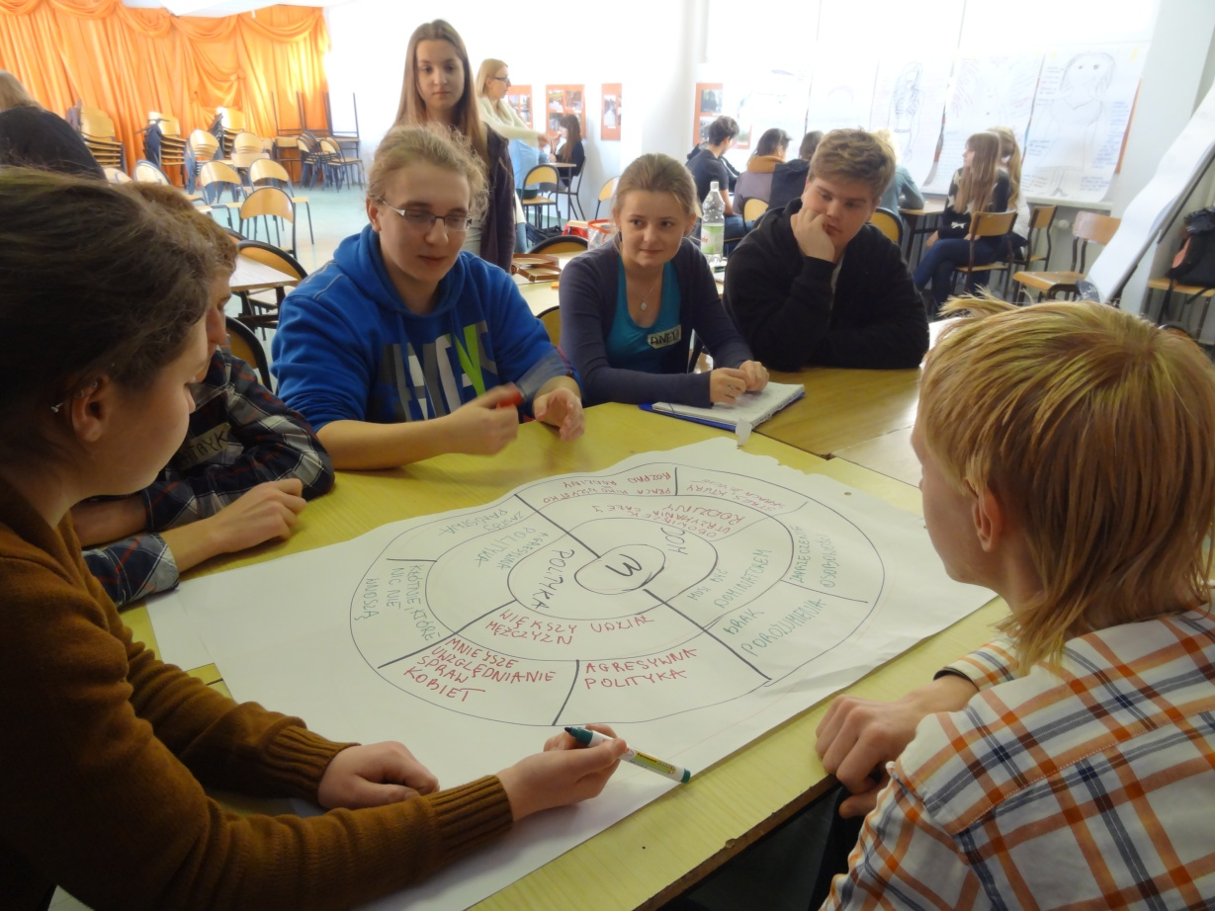
Activities during the workshops

Slide 9
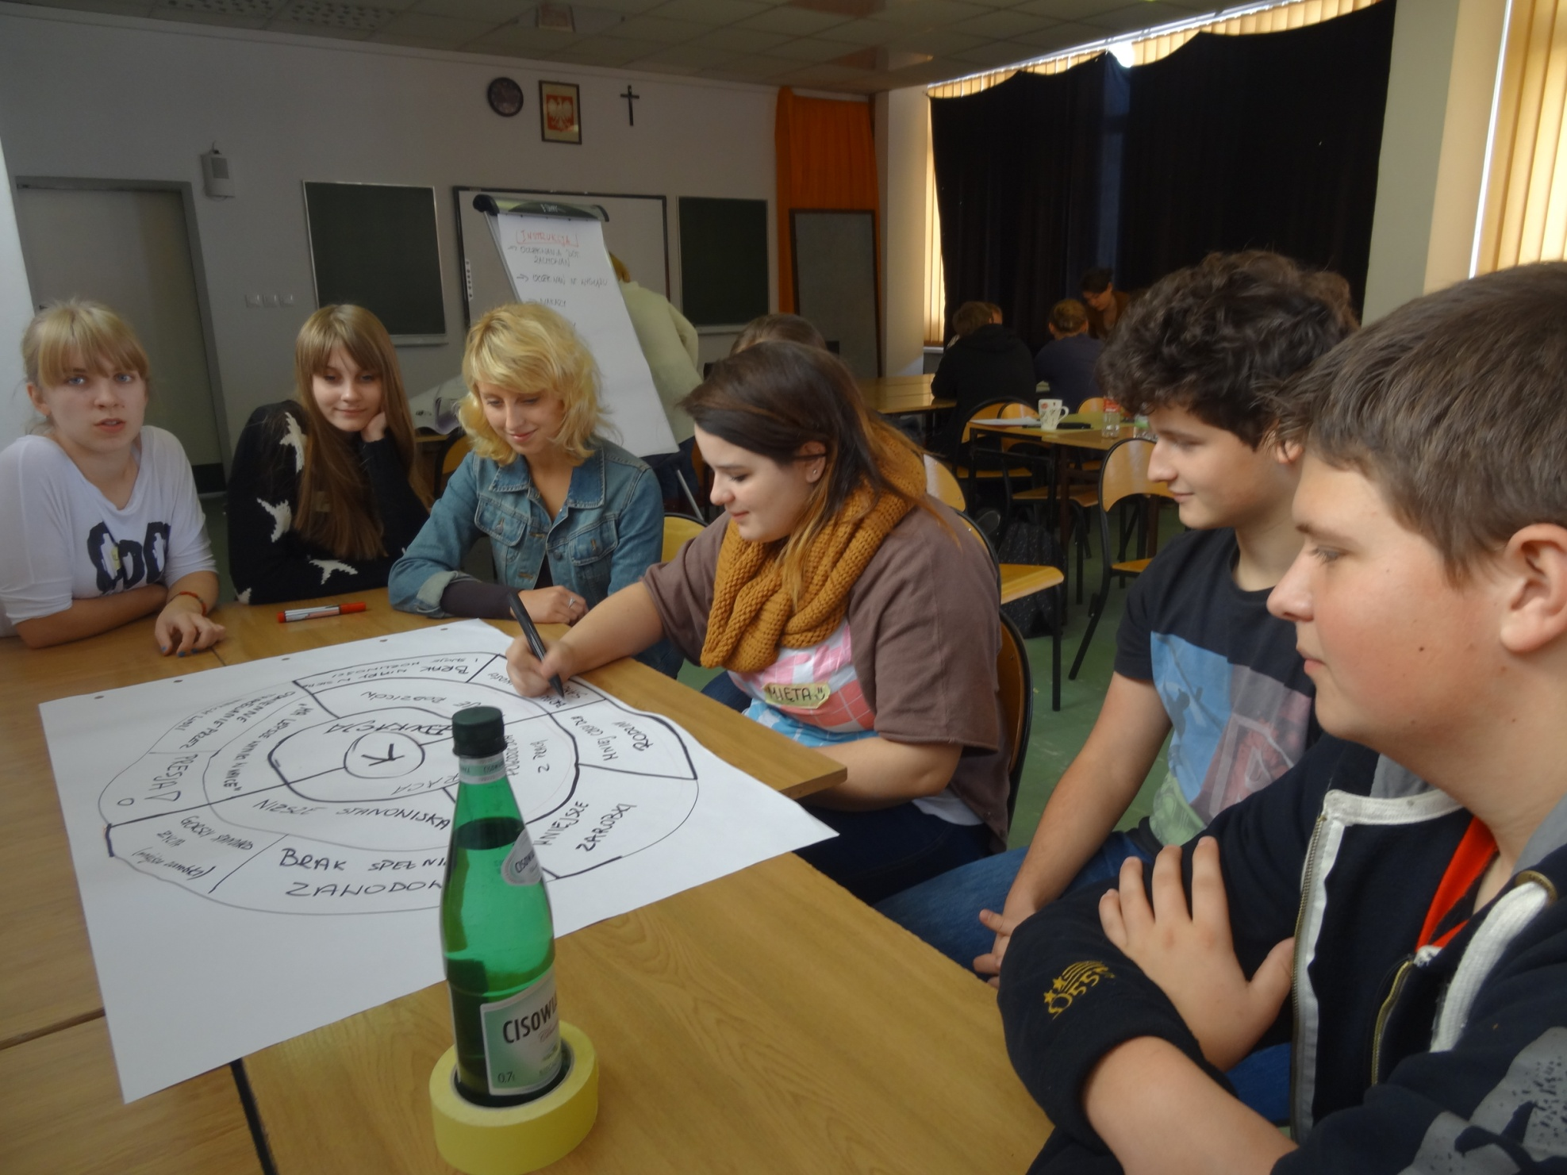
One of the groups at work

Slide 10
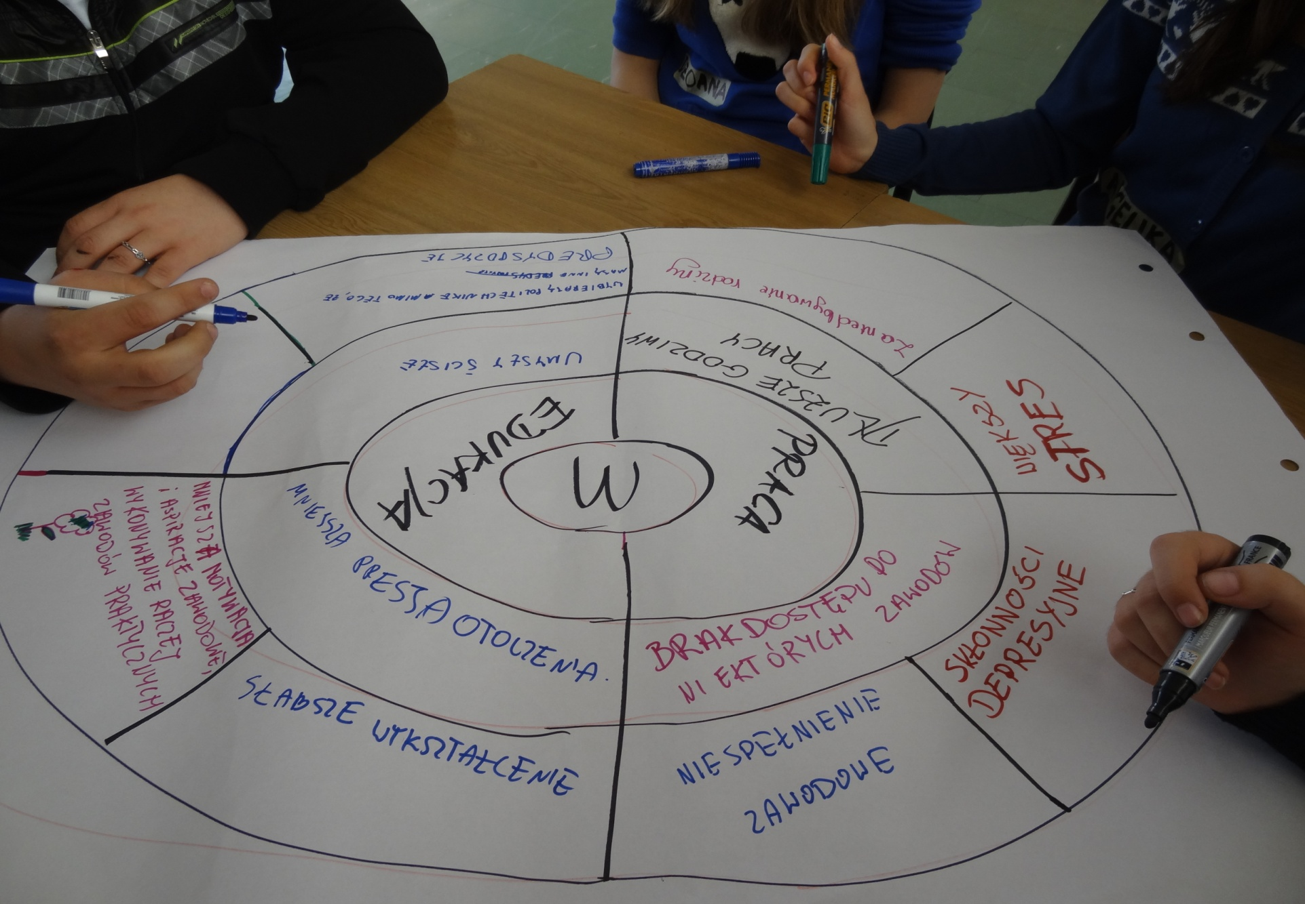
MEN - obstacles created by the stereotypes in education and work

Slide 11
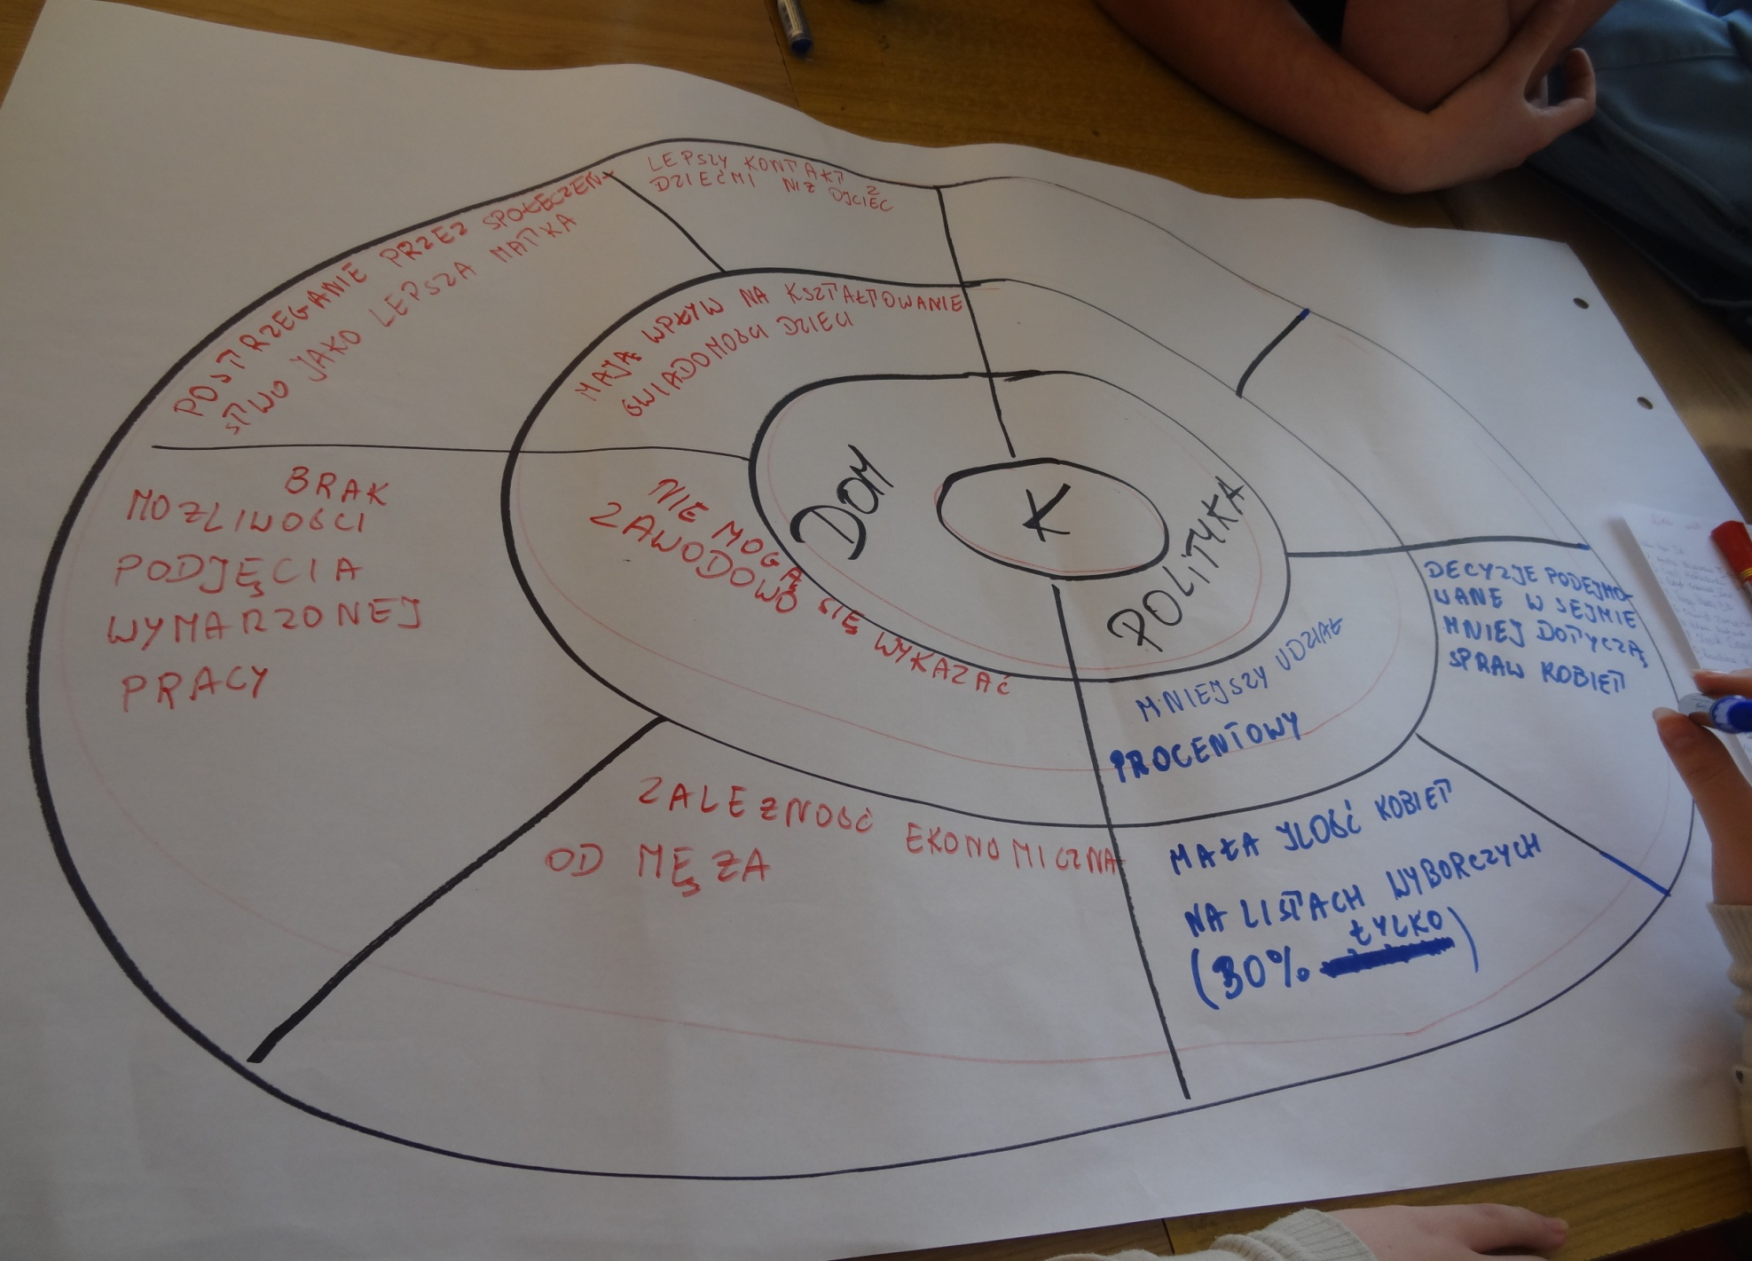
WOMEN - obstacles created by the stereotypes in such areas as household and politics

Slide 12
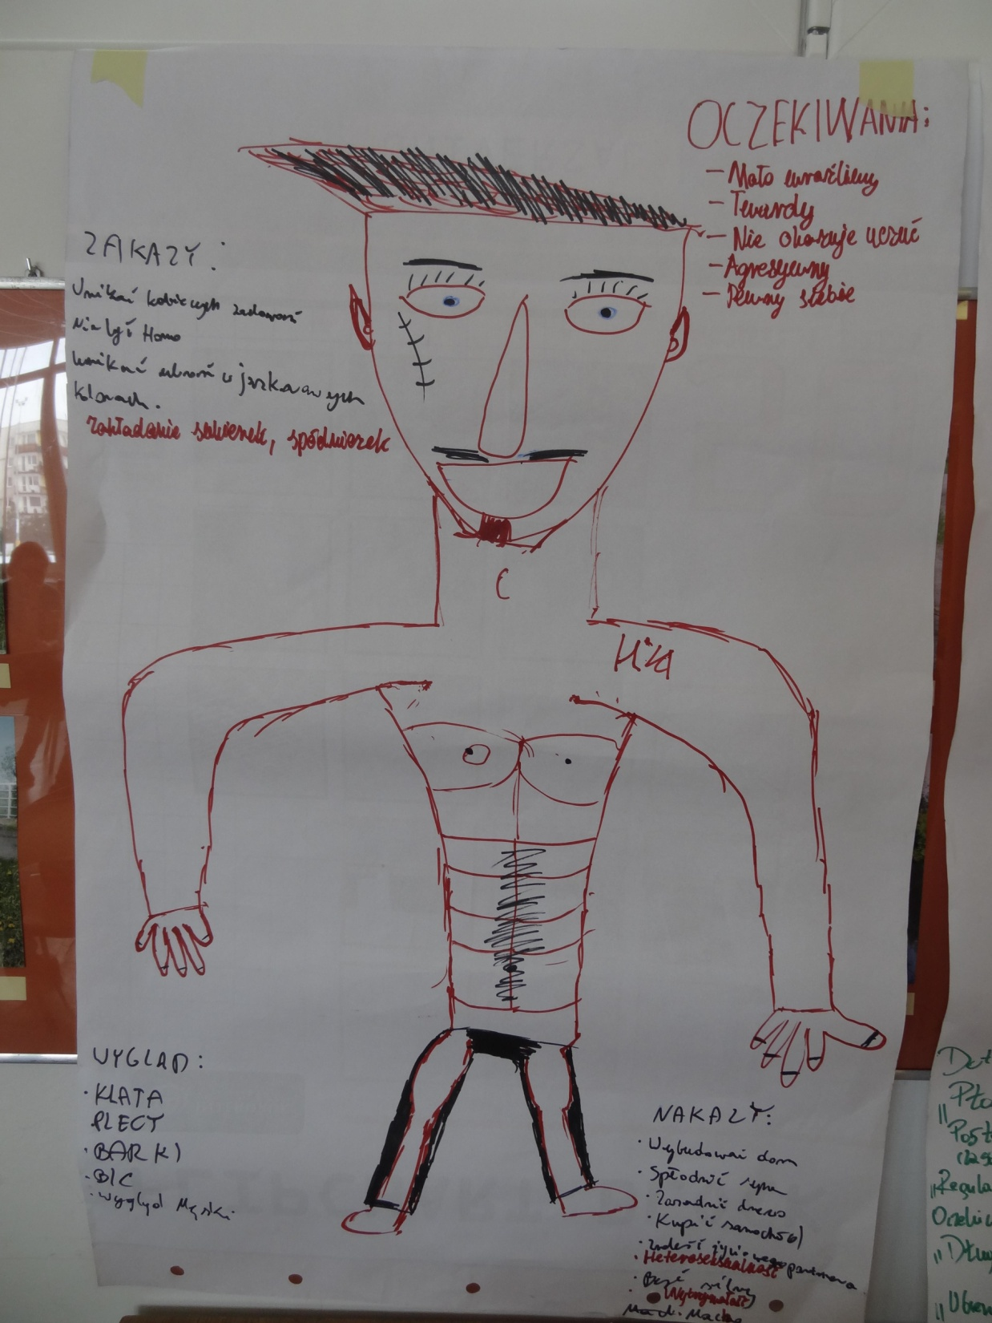
"The ideal man"
How do the process of education and other factors form the stereotype of masculinity?

Slide 13
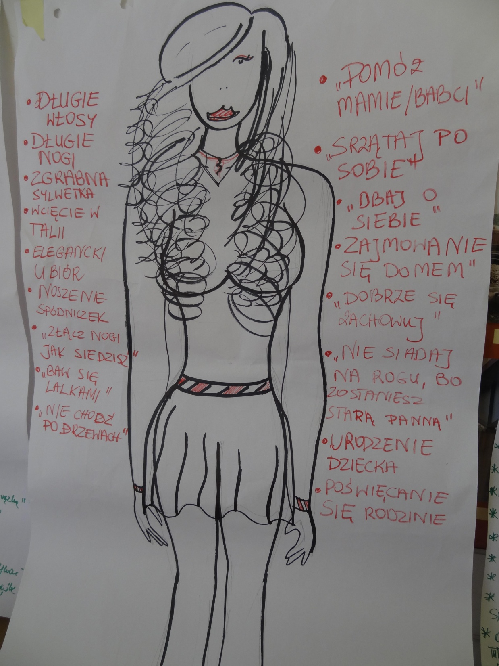
„The ideal woman"
How do the process of education and other factors form the stereotype of femininity?

Slide 14
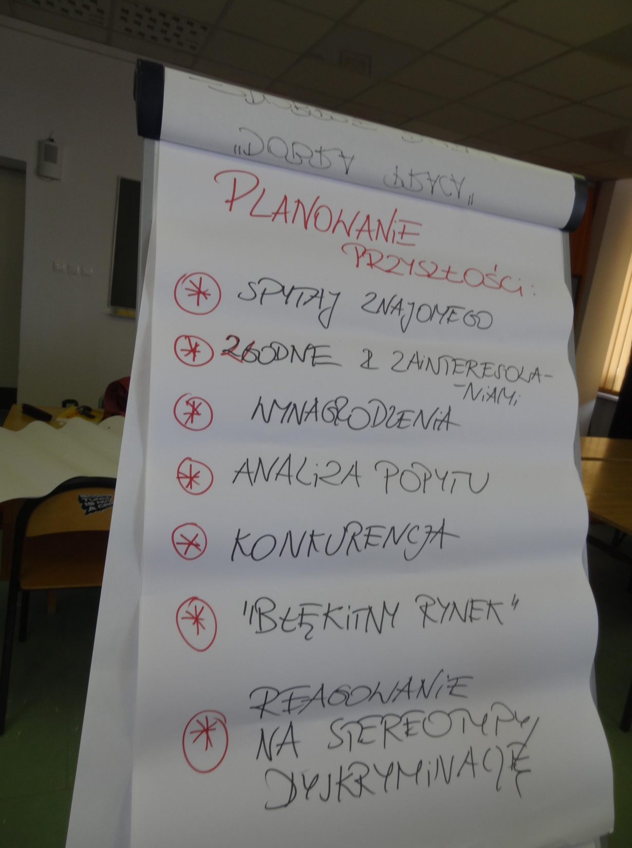
How to plan your future without stereotypes?
Follow your interests!
Include important values about which you care!
Don’t let stereotypes about occupations, which are only for men or women, influence your choices!

Slide 15
A survey
Students participating in the workshops were asked to complete a questionnaire
Questions and results:
Do the stereotypes put pressure on people choosing a certain type of education or
profession?
Give an example and explain briefly why?
Both male and female students gave an example of a woman driver who has a problem finding a job or is not associated with professionalism in this occupation. They also used an example of a man pursuing a job of a hairdresser, a dressmaker or a nursery worker. According to the opinion of both male and female students the society often labels such man as homosexuals, because they don’t accept the fact that “real” men could do such jobs. Respondents acknowledged that gender stereotypes often influence the choice of the discipline of study made ​​by girls and boys. They gave examples proving that women often choose humanities, while men dominate in technical disciplines.
2. Do you think that all occupations can be held by both women and men?
The respondents unanimously gave an affirmative answer, provided that the strength requirements are not beyond women’s capabilities.
3. Did you follow any gender stereotypes while choosing a course in your high school?
Again, all the respondents gave the same answer, which was No. Everybody was guided by their interests and by the offer of learning in a class with the programme that would give them better opportunities to prepare to enter the university they dream about.

Slide 16
A survey
Students participating in the workshops were asked to complete a questionnaire
Questions and results:
4. Did the activities help you to understand what Gender Mainstreaming is?
The whole group declared they understood the phenomenon and agreed there is a need to recognize the impact of gender on the position of men and women in a variety of important areas of life.
5. Do you think it was worth taking part in the workshops?
The respondents said that taking part in the workshop was a good decision if you wanted to deepen your knowledge of stereotyping and discrimination.
6. Would you like to participate in similar workshops?
All the answers were: YES.

Slide 17
Interview with Ewa Rutkowska October 26th, 2012
In the interview we were interested in findings concerning Polish schools in different areas of their operation in terms of compliance with the principles of gender equality.
We asked how to identify the mechanisms of discrimination.
Our interlocutor raised the question of the role of textbooks in strengthening gender stereotypes, and also the influence of the stereotypes on teacher-student relationships and the relationships between male and female students.
The interview drew our attention to an interesting phenomenon of the so-called gender-biased language and encouraged critical observation of the apparent under-representation of women in public, social and economic life. The interview resulted in significant conclusions on the main theme of the campaign, such as: Gender Mainstreaming is the awareness of the negative impact of gender stereotypes on the position of women and men, that we should take into account when making decision in important areas of social and political life. It is particularly important in those situations where the stereotypes unreasonably restrict health care, the idea of life prospects, relationships and roles in the family, a sense of duty, aspirations, etc. by belonging to the biological sex.
This interview can be found on the website:
www.lo.zyrardow.edu.pl

Slide 18
Interview with Agnieszka Sznajder October 30th, 2012
This interlocutor turned special attention to the pressure of gender stereotypes on the choices of girls and boys concerning disciplines of studies, which is still present in Polish education.
According to her, gender may discourage girls from „investing” in their careers, it may create "inequality" of opportunities to achieve academic or professional success for boys and girls, even if the latter make similar effort.
Taking the gender perspective in the way of looking at various issues in life into account, allows you to make important life choices more consciously. The perspective can also open you to the true needs of other people and encourage you to accept their choices, even different from the traditional ones.

Slide 19
Interview with Marta Siciarek October 18, 2012
This interlocutor drew attention to the new aspects of the subject and explained convincingly that gender appears in all forms of education and socialization.
Its influence begins almost from birth.
Parents caring for children and bringing them up usually use different behaviour models for boys and girls, which results from tradition.
This way of upbringing means forcing individuals into well-known, rigid roles, which are strongly approved of by general public.
A child is under the influence of gender from kindergarten and throughout the whole process of education. It is important to understand the negative manifestations of this phenomenon and to counter them effectively.

Slide 20
A display in our school hall: What is the new Comenius project about?
The main objective of the display was to familiarise students with the problems of discrimination and to present the questions addressed by the current Comenius project, the principal ones being Gender and Gender Mainstreaming.
The display presented the main points of our project.

Slide 21
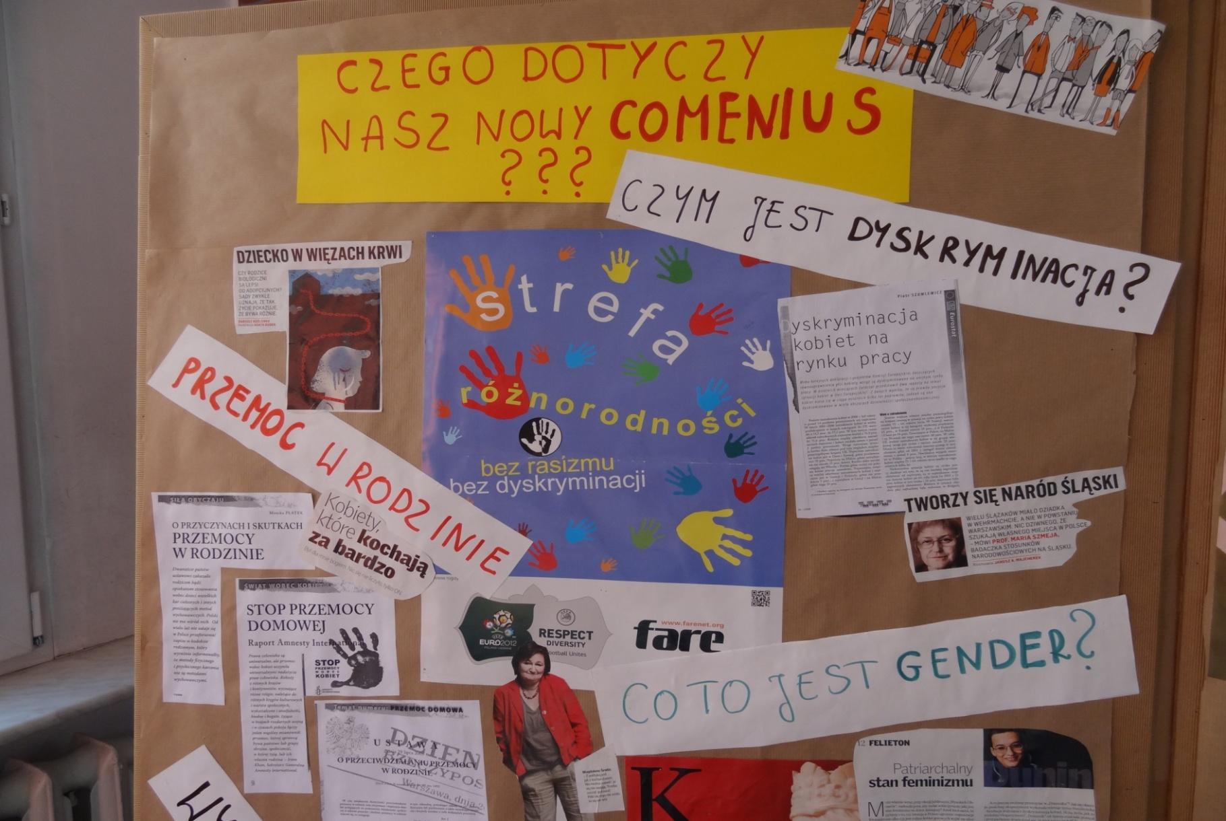
What is Gender?
What is discrimination?

Slide 22
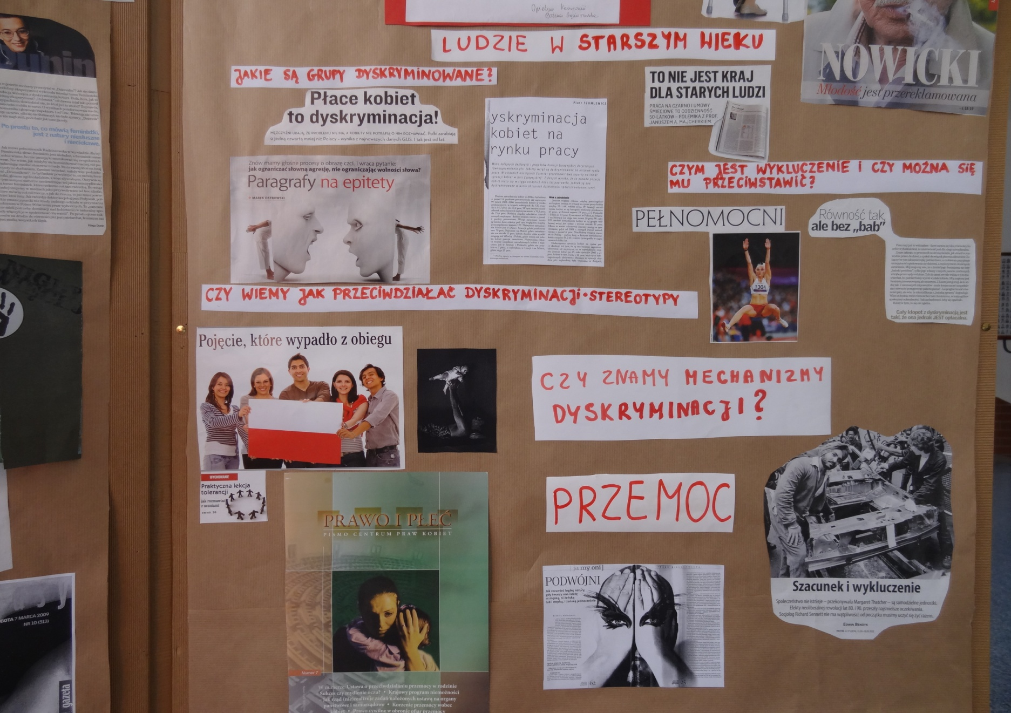
Do we know the mechanism of discrimination?
What groups are discriminated against?

Slide 23
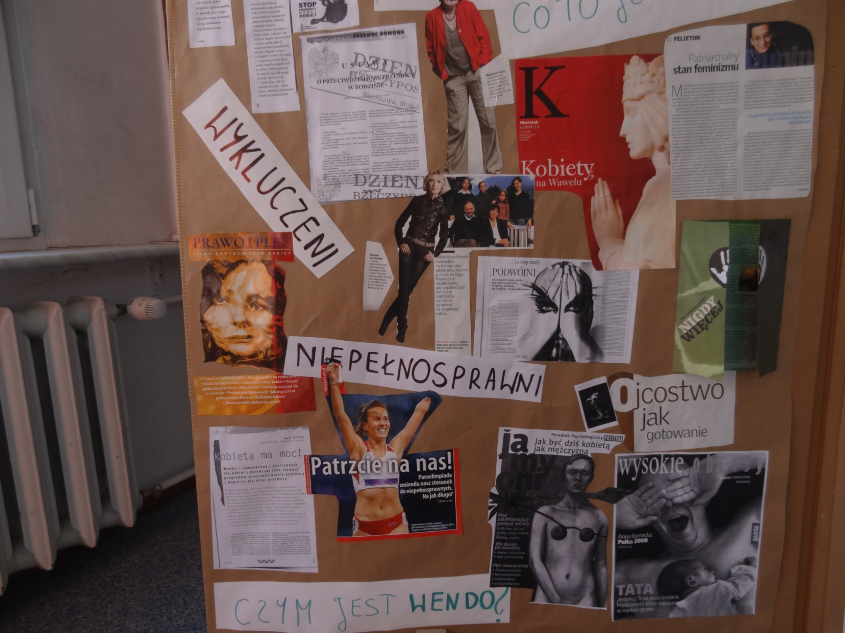
What is Wendo?

Slide 24
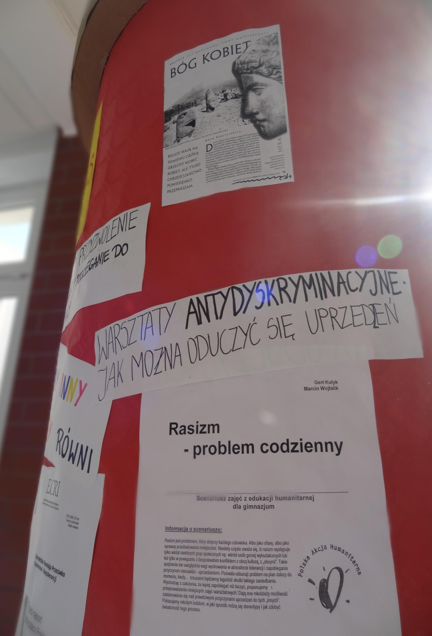
RACISM –
a problem that can emerge every day
Anti-discrimination workshops -
How can you learn not to be prejudiced?

Slide 25
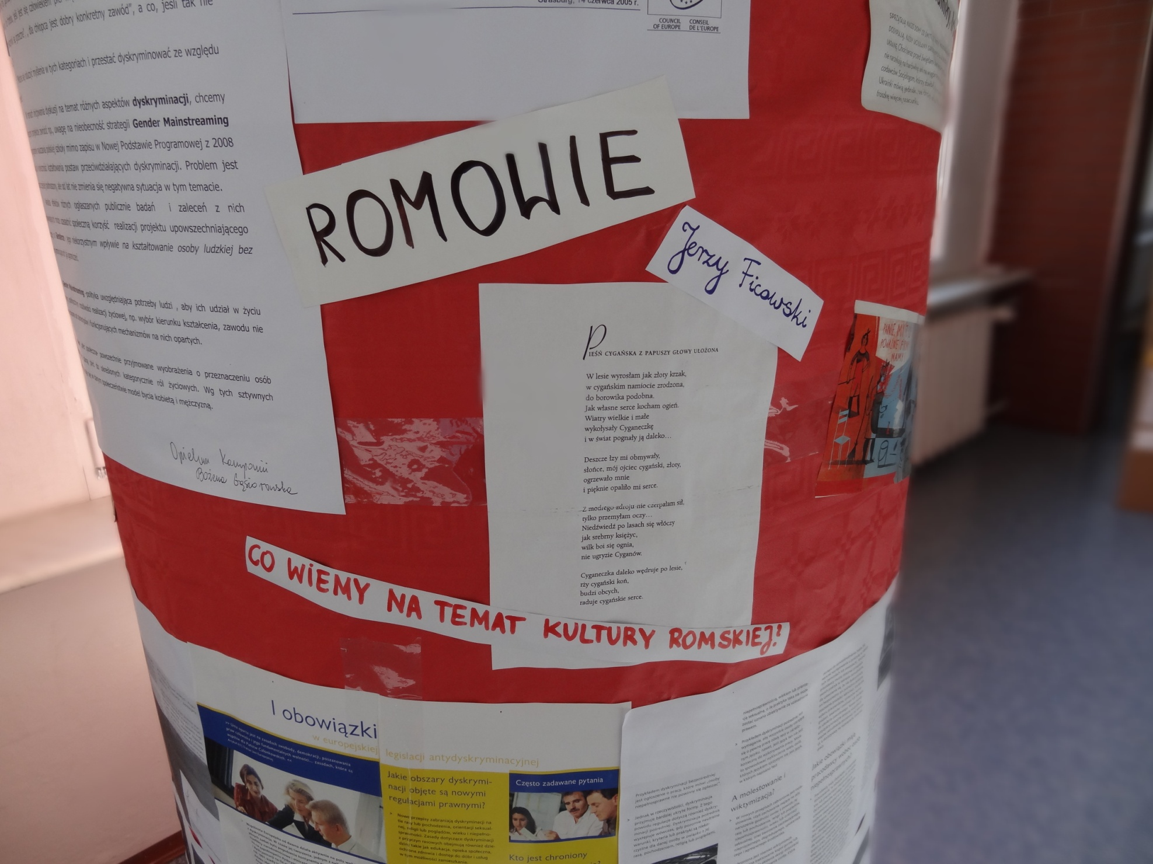
What do we know about the Romani culture?

Slide 26
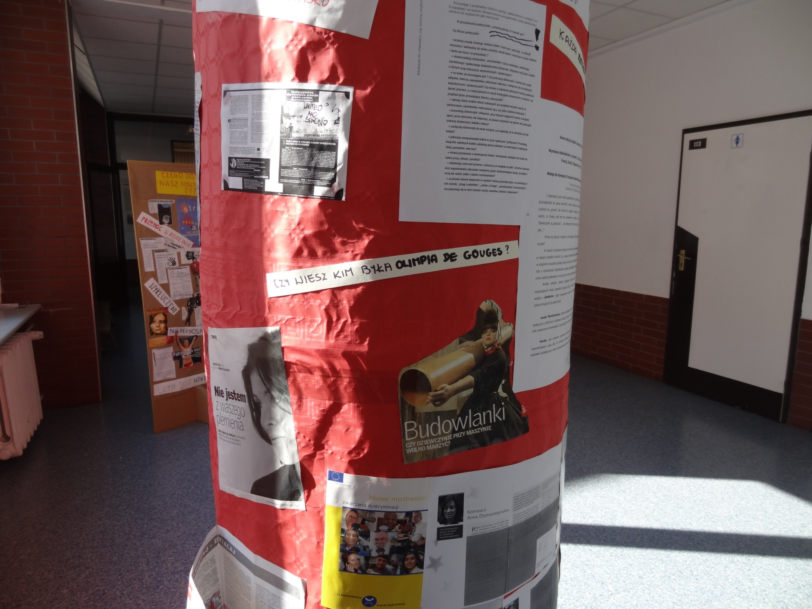
Do you know who Olimpia de Gouges was?

Slide 27
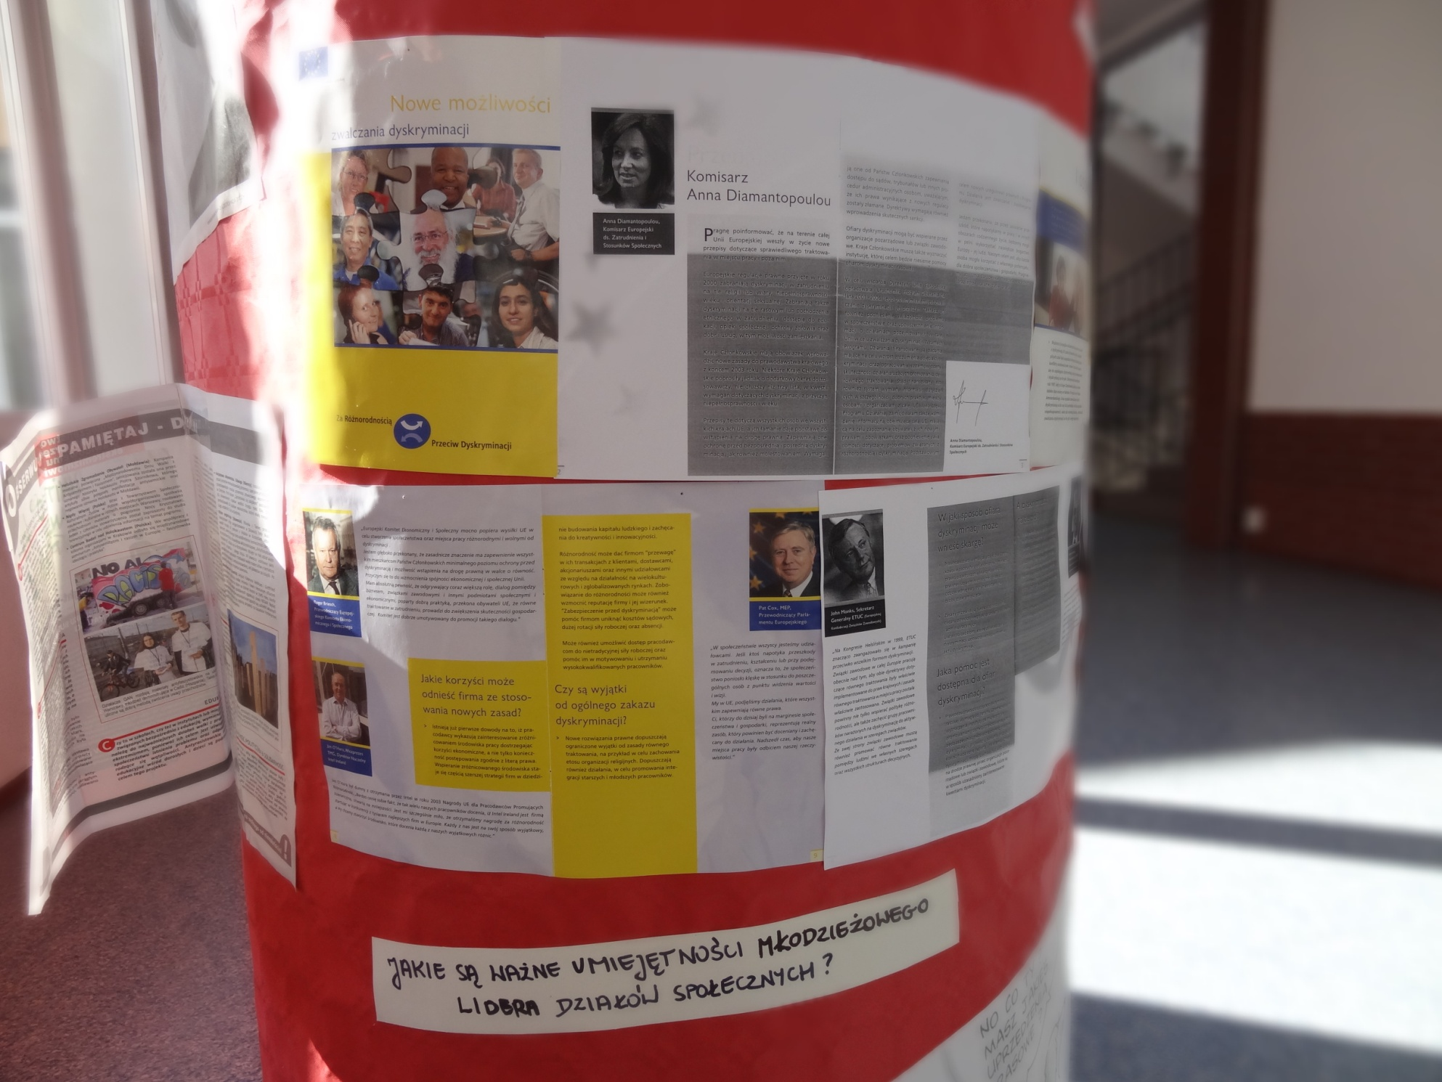
What are the important skills of a youth social action leader?

Slide 28
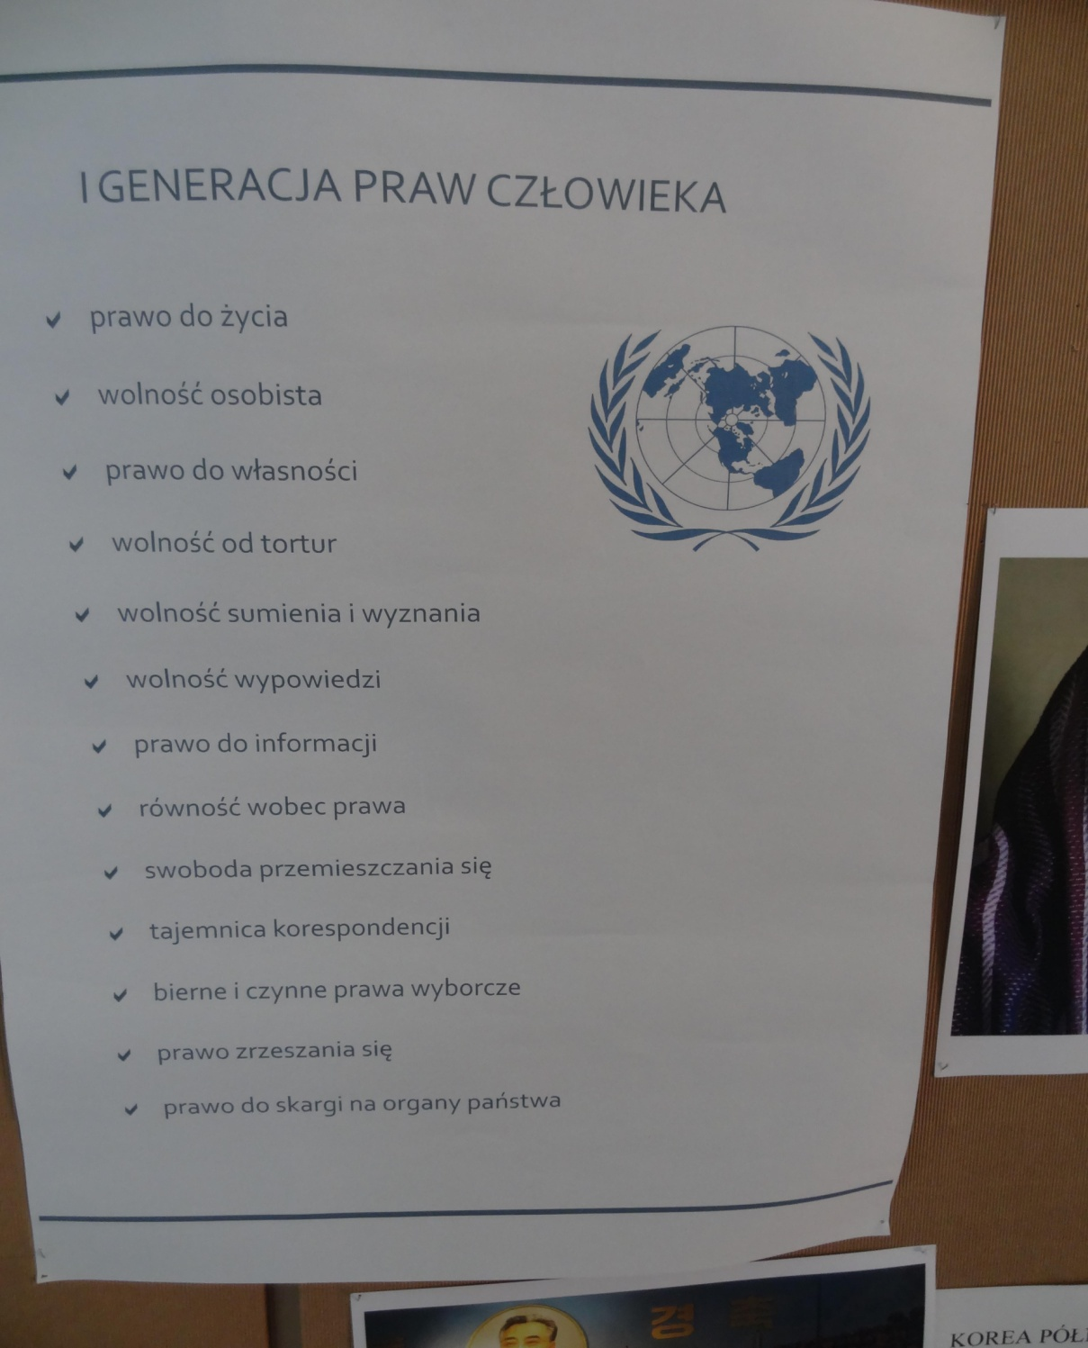
Get to know your rights!

Slide 29
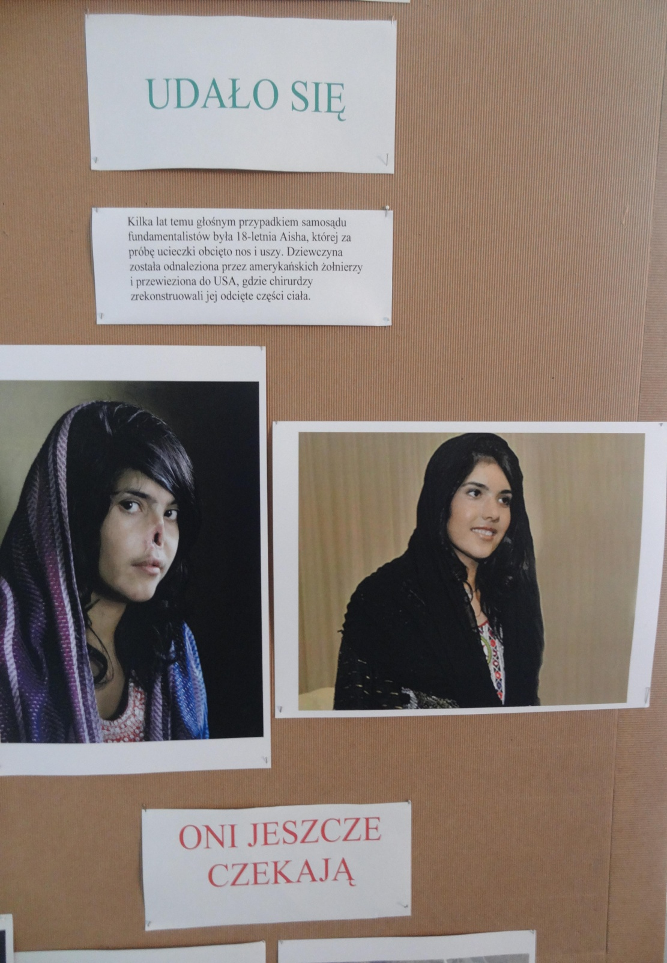
Violence against women in the world!

Slide 30
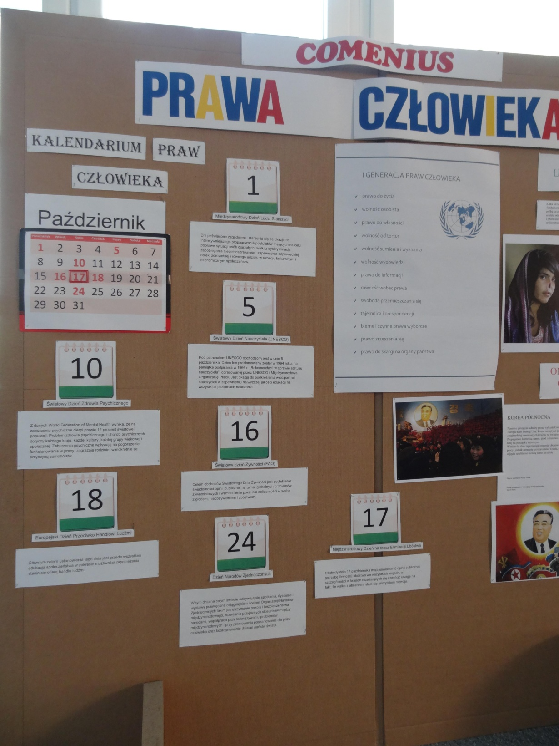
Calendar of human rights -
we emphasise the rights of women that protect them against discrimination

Slide 31
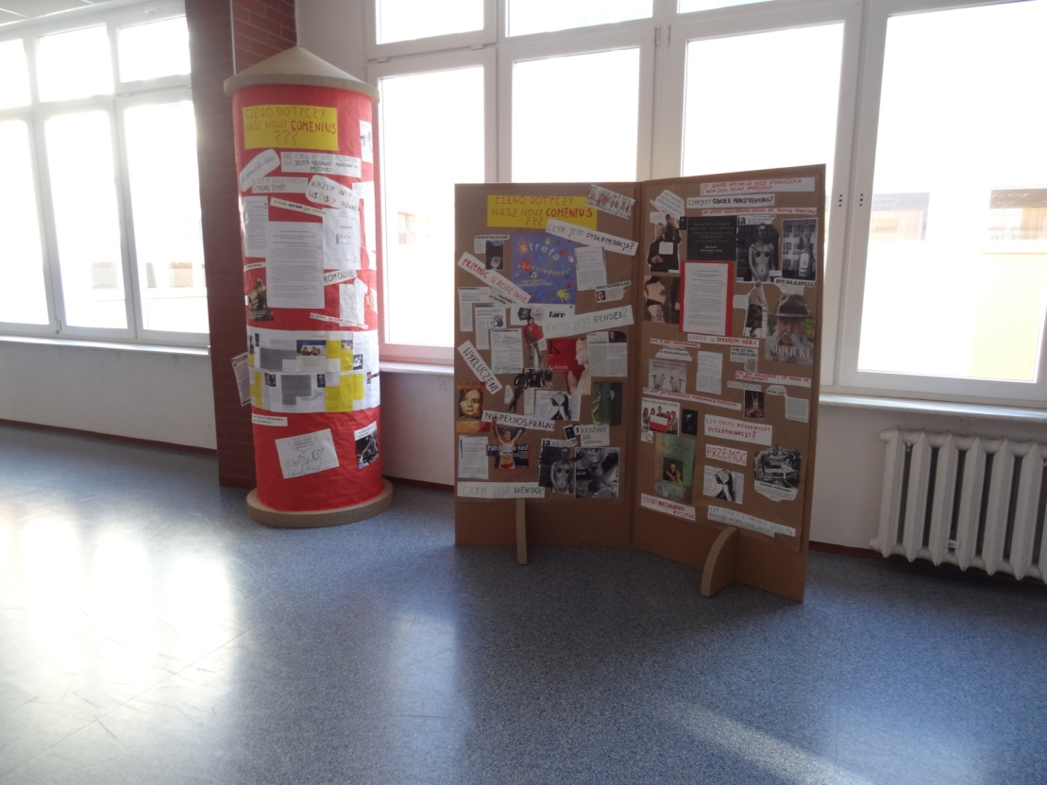
A survey
We carried out a survey among students of grades 1 and 2 to find out the level of interest in the display in the school hall.
RESULTS:
180 students did not even notice it
151 students noticed it
74 students claimed the articles presented in the display didn’t draw their attention.
This can be disturbing ...
46 students were able to name the titles of articles that were presented in the display

Slide 32
Poster Action as a result of a biology class
The students of class 2b were asked to carry out a task aimed at the dissemination of information on equality or lack of equality, disability, race and sexual preferences.
They created several graphic works that promoted the attitude of equality or rejected stereotypes. The posters presented diversity, which is the nature of the living world and the result of its evolution, and as such, it cannot be the reason for differentiation of rights or justification for a different perception and treatment of anyone.

Slide 33
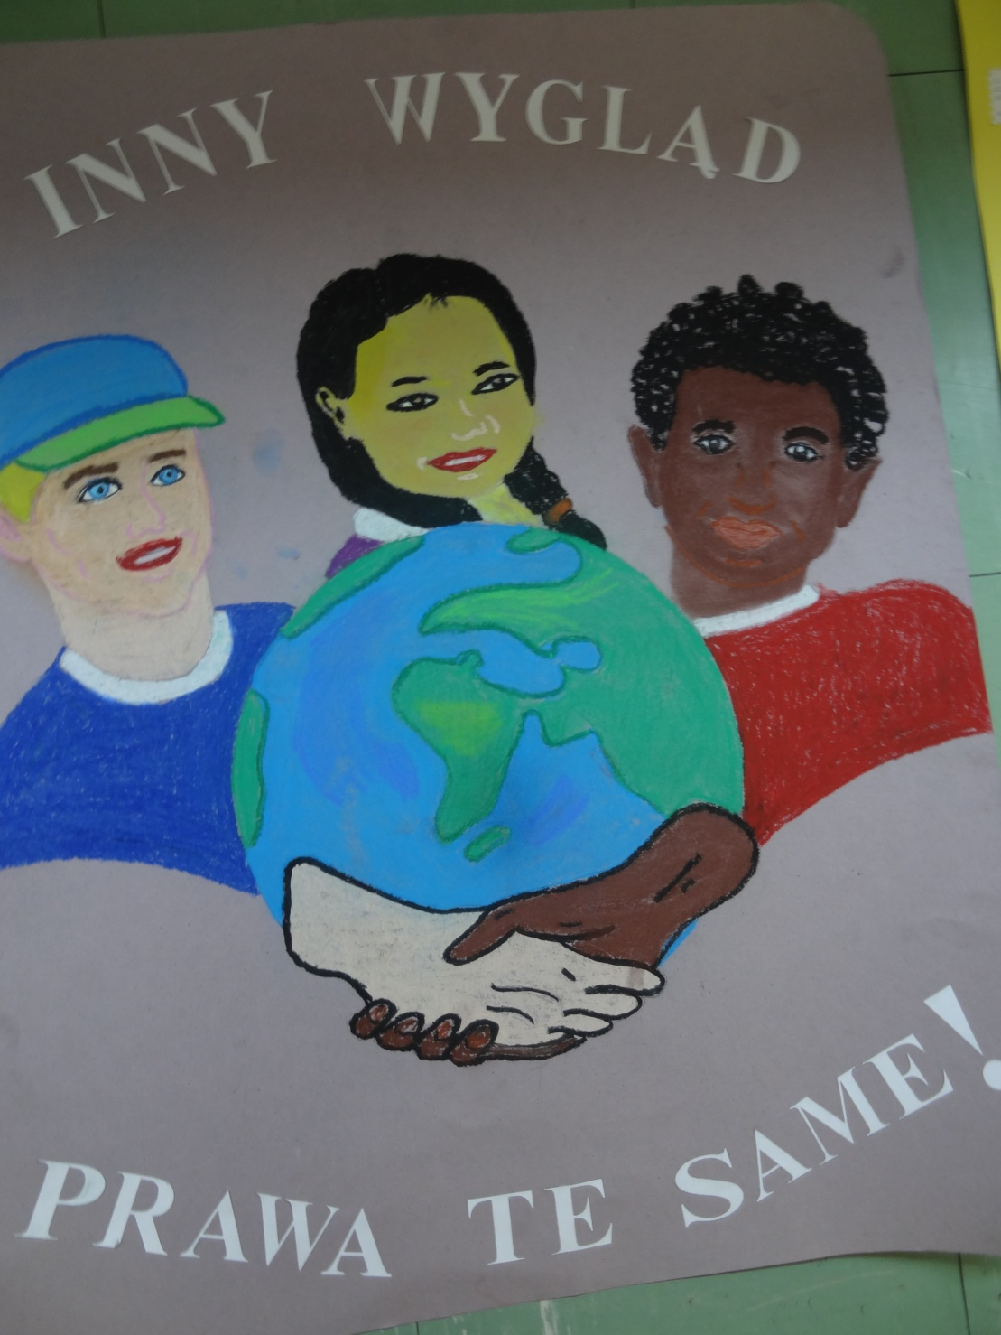
Posters promoting equality
Different appearance,
the same rights!

Slide 34
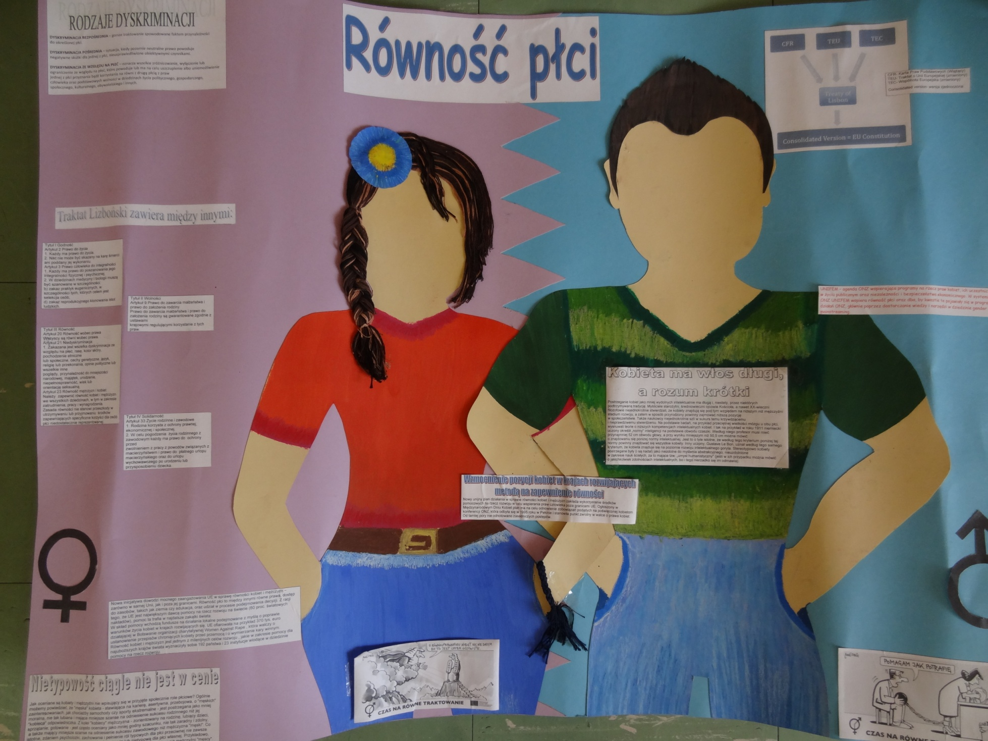
Gender equality

Slide 35
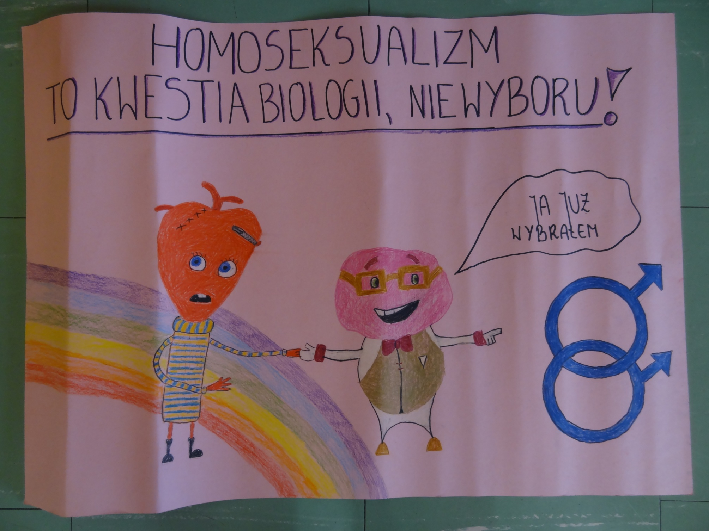
Homosexuality is a matter of biology, not a choice!

Slide 36
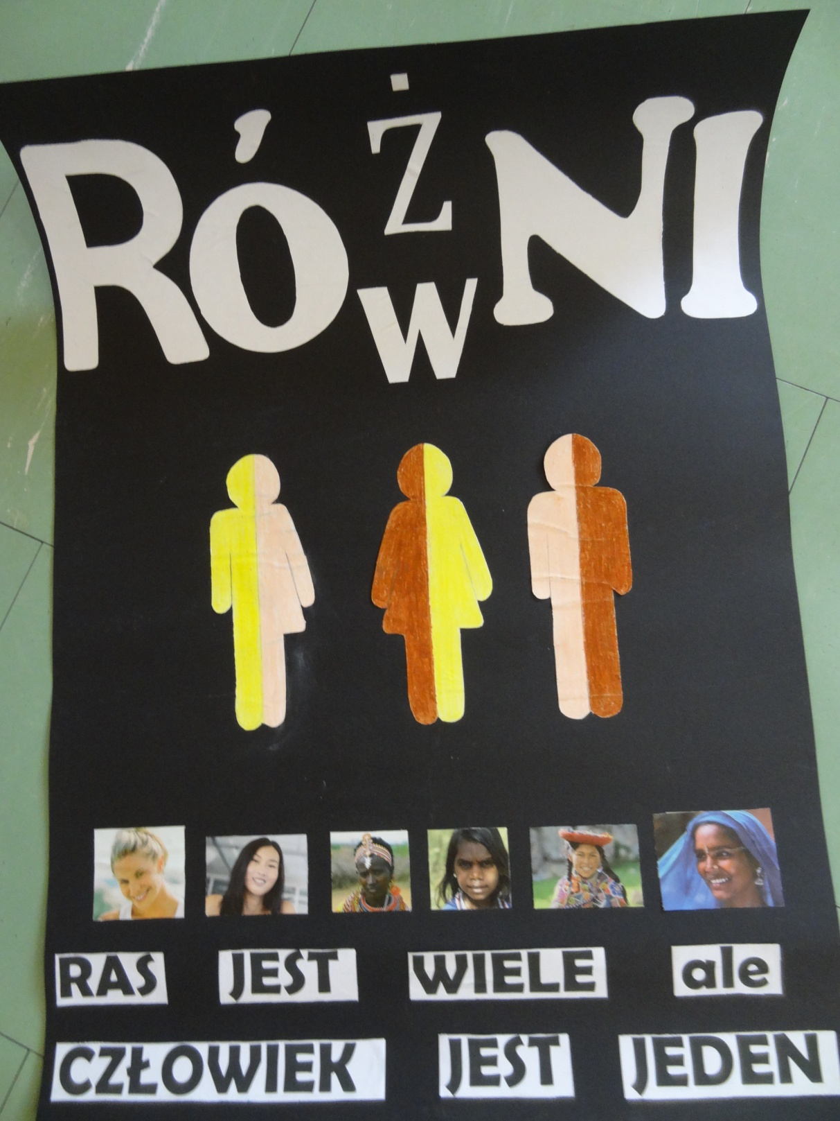
DIFFERENT
EQUAL

Slide 37
An article in the local newspaper „Tydzień Żyrardowa" (edition of 27th November, 2012)
„The theme of the Comenius project undertaken in Żeromski High School is closely associated with the concept of gender, which many of us don’t really understand. The students who are involved in this project, have a chance to become familiar with this concept through participation in workshops, reading information displayed in the school hall and interviewing people who are involved on a daily basis in the issues of equal opportunities ... "

Slide 38
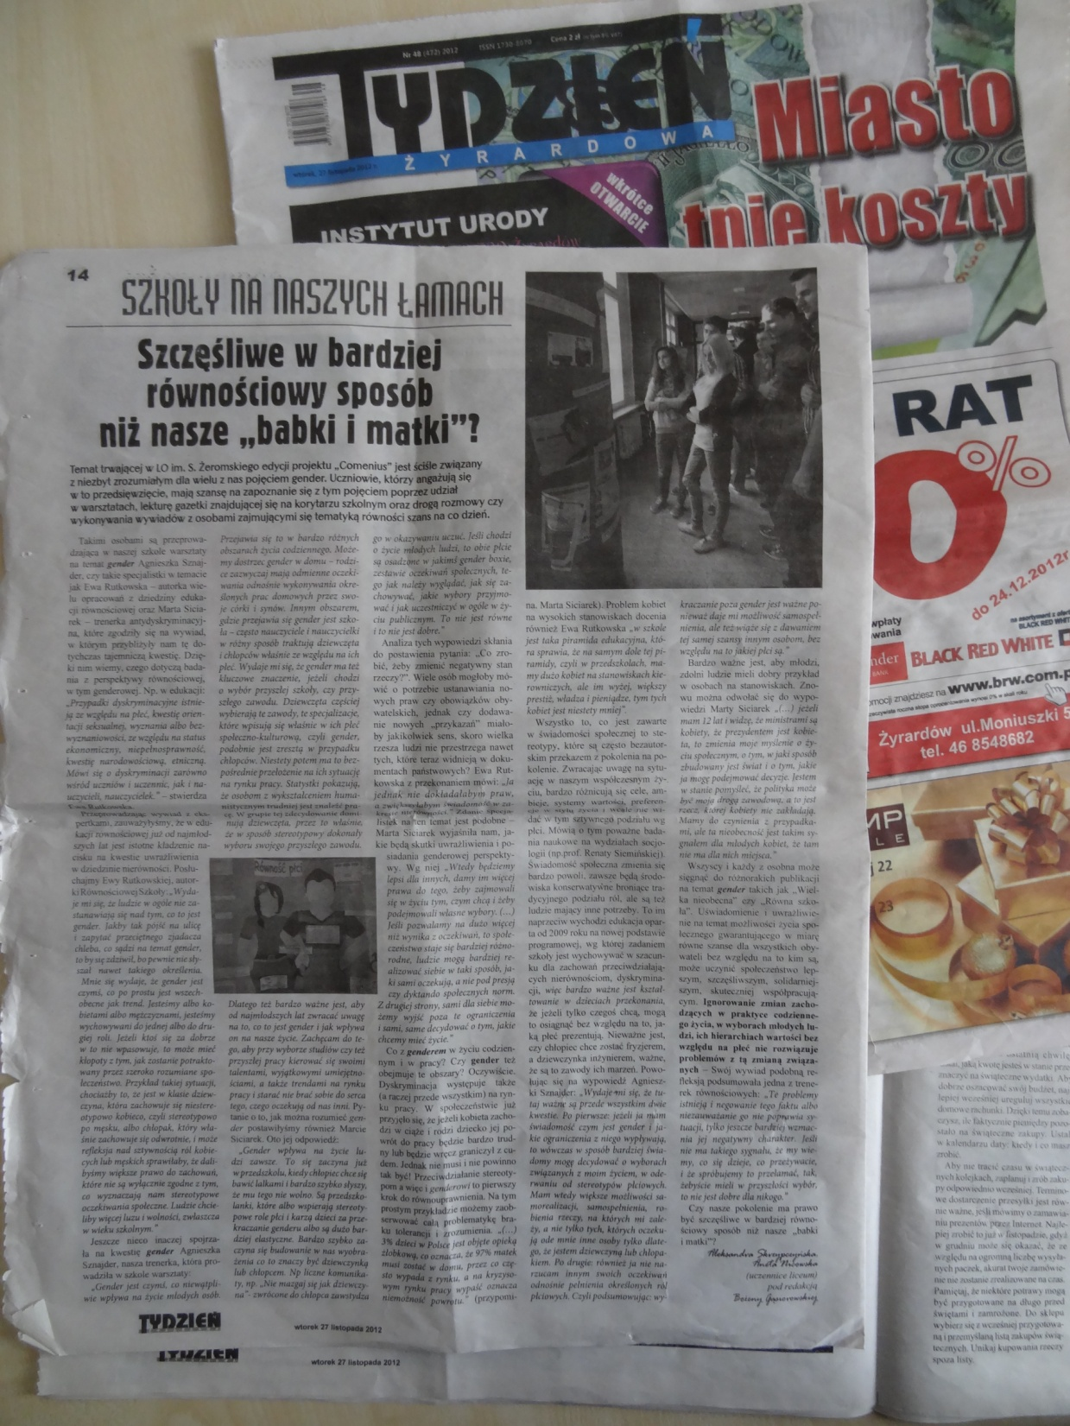
Are we better off in terms of equality than our mothers and grandmothers?

Slide 39
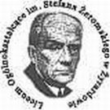
Stefan Żeromski
High School
6a J. Kacperskiej Street
96-300 Żyrardów
Phone: +48 46 855 31 22
Fax: +48 46 855 31 22
E-mail: lozyrard@lo.zyrardow.edu.pl
www.lo.zyrardow.edu.pl
Editor: Karolina Rutkowska, IID
Technical and stylistic consultant: Bożena Gąsiorowska
English language consultant: Danuta Czyżewska
Pictures, texts, materials collected in the project.

