Slide 1
Meeting with difficult topics in films. In Stefan Żeromski Highschool in Żyrardów. IX 2012-VI 2013

Slide 2
Difficult topics - our meetings with films IX 2012-Vi 2013
The problem of violence, lack of tolerance for ethnic, religious, racial or sexual diversity, or exploitation of the poorest
Selected films from the series Difficult Topics encourage discussion, make you sensitive to the fate of others and help you to understand the complexity of the world.

Slide 3
Films watched in the series Difficult topics:
The Believer
C.R.A.Z.Y.
Wymyk (A Dodge)
China Blue
Berlin Calling
Yo, también (Me, too!)
XXY
Intouchables (The Untouchable)
Kielletty hedelmä (Forbidden Fruit)

Slide 4
The Believer – It’s film about xenophobia
This film is about a young Jewish boy who does not accept his identity. His experiences in a Jewish school generate in him a deep hatred for the Jews – make him an anti-Semite, and what happens next we can see in the film.
USA 2001
Director: H.Bean

Slide 5
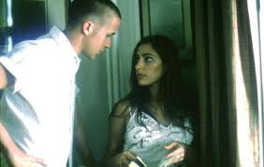
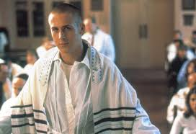
„The Believer” convinces us that "the best stories are written by life itself.".
This film explains the reasons that might have led the main character to start to fight against its own origin, religion and culture.
The story told in film seems to be unlikely.

Slide 6
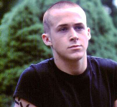
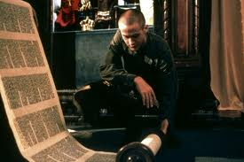
The main strength of the film
is excellent acting of the actor,
Ryan Gosling.
The hero has a strong personality. Up to a certain point he is a racist, but when his conscience wakes up in him, everything becomes complicated .

Slide 7
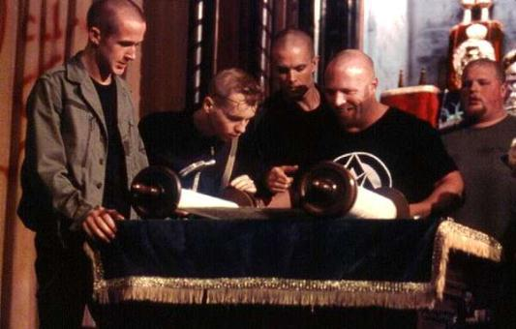
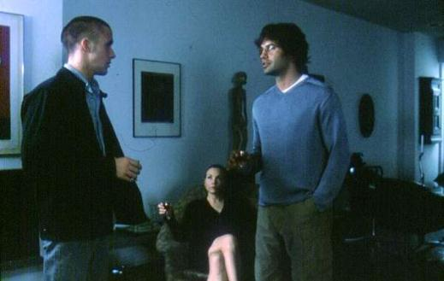
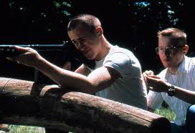

Slide 8
Together with the film we received interesting materials about discrimination. We also got in touch with a society called Open Rzeczpospolita (Republic of Poland), which prevents various forms of hatred based on race, ethnicity or nationality.

Slide 9
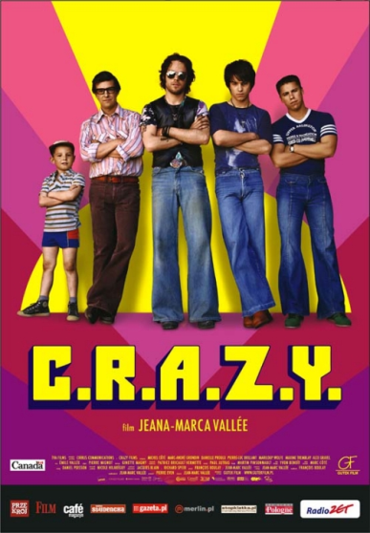
C.R.A.Z.Y.- a film inspiring difficult discussions about homosexuality.
C.R.A.Z.Y. is not a gay film, it does not idealise homosexual love or does not show it in a vulgar way
Canada 2005
Director: J.M. Vallee

Slide 10
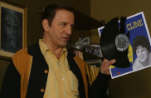
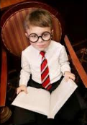
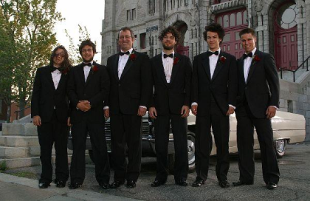
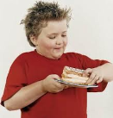
The film encourages discussion about models of masculinity and their confrontation with homosexuality. In the film, the Father – an example of a macho, a conservative, "homophobic" - and his sons feel superior to a sensitive and lost Zac, who is trying to escape from his homosexual identity.

Slide 11
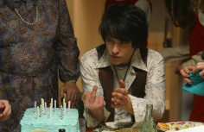
The director shows typical problems of adolescence and the difficult issue of sexual diversity, which is generally unacceptable. It presents the drama of a young man who has realised he is homosexual and is looking for understanding, love and acceptance in the family. The film presents difficult choices made by the members of this family..
Notes:
od

Slide 12
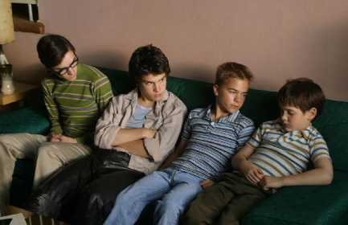
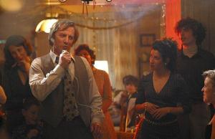
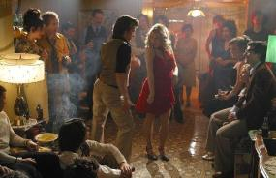
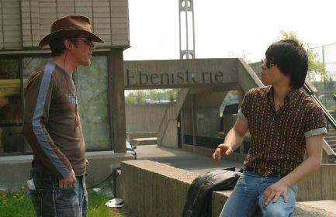

Slide 13
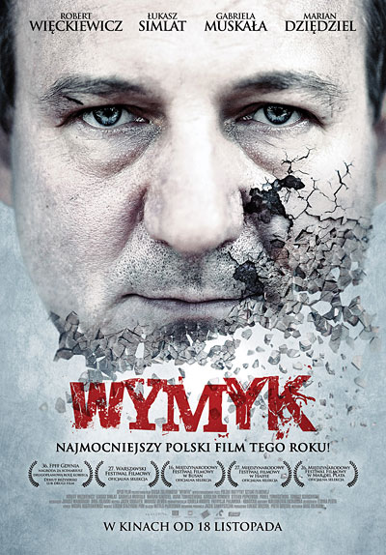
A Dodge - It’s a film about responsibility we are not always capable of taking. It is also about thoughtless violence..
The film presents a story of two brothers – Alfred and Jerzy – who, during a journey on a suburban train, witness a brutal attack on a young girl. One of them stands up to violence but the other chickens out.
Poland 2011
Director: G. Zgliński

Slide 14
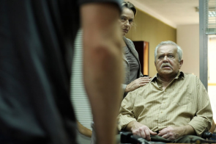
The film is a psychological study of a man who can’t accept his cowardice.
We feel that the story of the brothers in the film somehow repeats the biblical story of Cain and Abel, but it is not a simple repetition and has a very different ending. We recommend you to see this good Polish film!

Slide 15
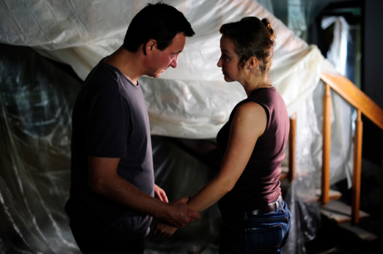
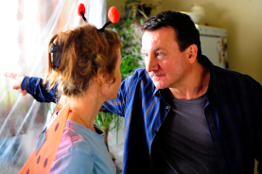
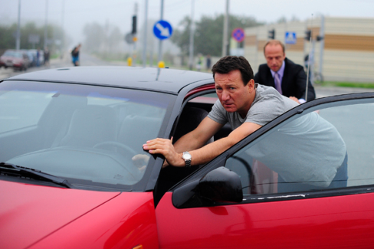

Slide 16
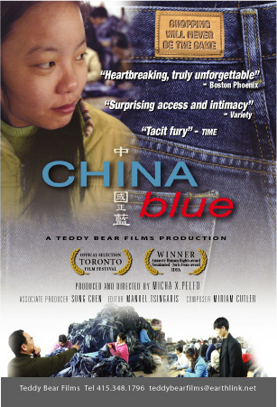
China blue - It is a well-known documentary about violation of the human rights in China.
It’s a film about Chinese teenagers working in a garment factory. Buying various designer clothes, we forget that they are sewn in China in such conditions as those in Lifeng Factory in Shaxi, in which very young Chinese women work.
USA 2005
Director: M.X. Peled

Slide 17
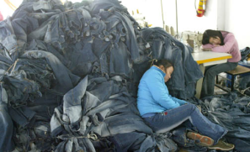
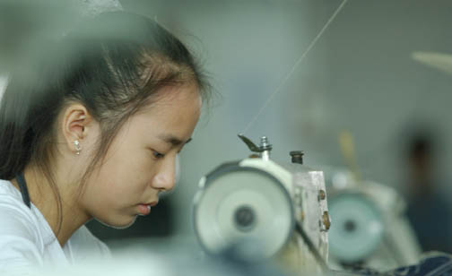
The film shows violations of fundamental workers' rights, strict rules of reward and punishment, extremely low wages and ruthless exploitation of cheap labour.

Slide 18
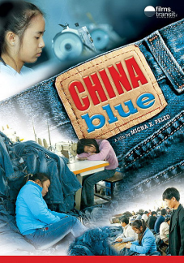
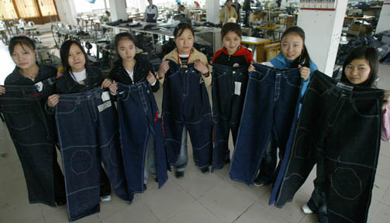
During the 90 minutes of the duration of the film, its young Chinese characters sew 15 pairs of jeans and earn in total only $ 1.45. Perhaps young people all over the world should protest against such abuse instead of benefiting from it? Can it be done and how to do it?

Slide 19
Summary of the films we have seen:
Thanks to these films we have learnt more about various aspects of discrimination, violence or exclusion: bigotry, gay issues and the problem of complying with the stereotype of masculinity, currently functioning in our culture, the problem of living with the awareness of your own cowardice or economic exploitation of children and adults.

Slide 20
Me, too!- it’s a film about a difficult issue of living with mental disability
The film makes you realize that disability does not necessarily mean a lack of independence ... and tells you how to help the disabled.
Spain 2009
Director: A.Pastor, A.Naharro

Slide 21
Xxy - We are waiting impatiently for the film about a quest for identity
Alex is 15 years old. As a hermaphrodite, he must decide on his gender. We will discuss whether the young man can live in harmony with himself in such a situation and also what impact his environment has on him.
Argentina 2007
Director: L.Puenzo

Slide 22
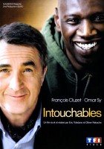
The Untouchable - A film about the problem of using a wheelchair. Does this necessarily mean you are excluded? How to avoid it?
France 2011
Director: O.Nakache, E,Toldano

Slide 23
Forbidden Fruit - An interesting story about the problems of entering into adulthood
Finland, Sweden2009
Director: D.Karukoski

Slide 24
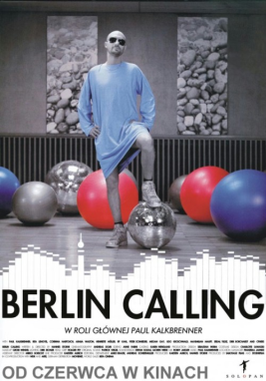
Berlin Calling - A film about addictions
Germany 2006
Director: H.Stohr

Slide 25
Meetings with films in our town cinema Len are held within the Comenius project "School factory of initiatives, equal citizenship".”.

Slide 26
Prepared by Sylwia Szczepańska IB
Bibliography:
www.filmweb.pl
www.wdk-kielce.pl
www.nhef.pl
Project materials:
www.stopklatka.pl
www.wikipedia.pl

