Slide 1
THE BLACK BOOK
The exploitation of woman's Body in advertising

Slide 2
LARNACA TECHNICAL SCHOOL
II I
It is with a great pleasure to present to all of you our project ‘’THE BLACK BOOK ‘’which is referring to the exploitation of woman’s body in advertising. This project could not be done without your help. We do thank you and hope for a fruitful cooperation in the near future. It was a unique experience for the teachers but above all was for our students.
Equal Rights
Equal Opportunities

Slide 3
The woman and her body have been exploited since they invented the mass media and advertising was introduced as a means of promoting products.

Slide 4
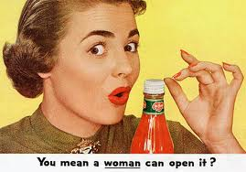
Is it a man’s world?
Woman’s capabilities are underestimated on this photo.

Slide 5
SkyyVodka advertisement A clear message to both men and women : “The message is that men should have control over women. These types of messages also encourage male violence.” (Quote from Tiffany )
The Misogynistic Depiction of Women in Advertising

Slide 7
WE DON’T ACCEPT IT!
This add reminds us of a gang rape scene.
So what message is this advertisement sending?
It is a fact that men are more likely to commit a violent crime than females are.
With advertisements like this one from D&G, the media is sending a clear message to people.
Is this advertisement a good example for our young people?
They learn about how to treat women and about the position and role of women in society.
This is not the way it should be!

Slide 8
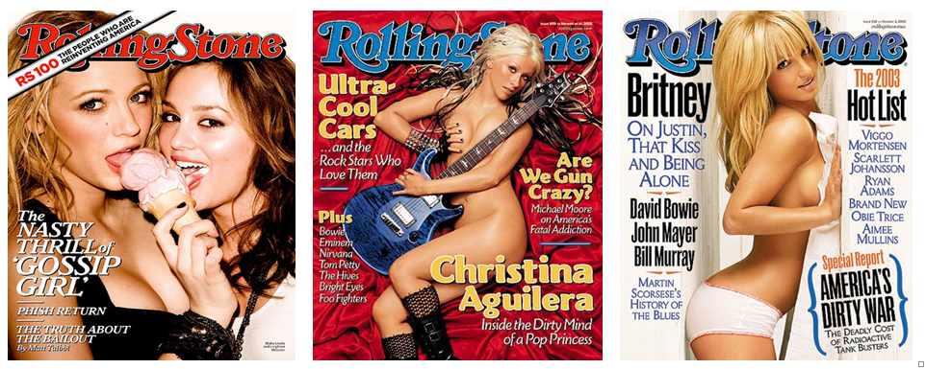
RollingStone Hyper-sexualized images of women are very common.
Actually they are much more common than non-sexualised images of women.
Some of these cover pages are even “pornified” as can be clearly seen from the examples .
It’s much more likely that we see ads were women are sexualised than men.

Slide 9
This is a typical “sexpot” advertisement: the woman is sexy, wearing a very short and tight Gucci dress. The man is presumably also wearing an elegant Gucci suit. The question is: What is Gucci trying to sell with this picture? Is it perhaps telling us that women who wear Gucci dresses are happy to be spanked by men in Gucci dresses or at least that is what they deserve? Or is it saying that gender violence and domestic abuse is ok if you are wearing the right clothes? Or is it perhaps saying that domestic violence also exists among rich people?
We would appreciate an answer!

Slide 10
It’s an advert of a mobile phone operator. The small text in white says: “Some things are only for real men.”

Slide 11
The slogan says: “BE SINFUL”. The red part of the word “sinful” in Polish means “sin” as a verb in imperative (often used euphemistically “have sex”, especially outside marriage, though not necessarily). What’s more, in Polish “Be nice” is “Bądź grzeczny”, which differs only with one letter from “Bądź grzeszny” used in the advertisement.

Slide 12
The slogan says: “Take a photo of me and ... discover my hidden secret.”

Slide 13
An advert for a cottage cheese with strawberries. The slogan says: “Cottage cheese from Chojnice ... sin worthy”. When we say in Polish a woman is sin worthy, we mean she is very attractive sexually.

Slide 14
Hot chick The most terrible Hungarian advertisement in connection with humiliating women, which was designed by Zala poultry factory You can see the parts of a chicken on the woman’s body (wings, back, thighs and shanks) Would you like to see any of your female relatives there?

Slide 15
Traubisoda Drink something good! Do something good!
This is a poster from the ’80s which shows a special Hungarian drink, called Traubisoda It is very eye-catching, because they used women’s nice, long legs to advertise the drink

Slide 16
When I grow up I’d like to be a boy Help us to root out the prejudice concerning stereotypes of women!
Don’t use women’s body to advertise everything!
Don’t make women believe they are gorgeous just to use them in advertisements!
Women like when you look at them, but not when you stare at them!
Don’t handle them as an object!

Slide 17
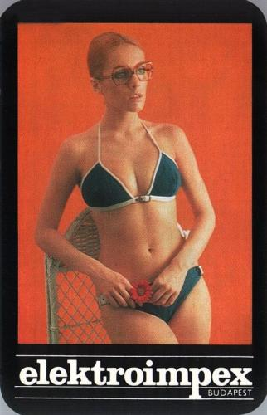
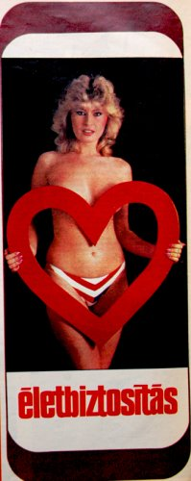
Guess! What do these pictures advertise? Just women, don’t they?
Traubisoda (drink)
Gyöngy (drink)
Telecommunication company
Insurance company
Savings bank
Life insurance

Slide 18
It’s an advert for gypsum plaster. It uses a play on words. “Gładź, gładź, gładź” means “stroke, stroke, stroke” but the word “gładź” also means “gypsum plaster”.

Slide 19
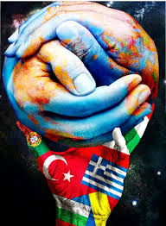
The Black Book Comenius School Project 2012 - 2014

