Slide 1
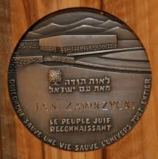
The righteous" are a challenge for us Activities commemorating the fact that Jan Michał Langiewicz – the former headmaster of LO im. S. Żeromskiego [in the 60s and 70s of the 20th century] - was awarded a medal of the Righteous Among the Nations
The last Comenius task in the Young Citizen
programme of the Centre for Civic Education (III module)

Slide 2
The title of our task – „The righteous” are a challenge for us

Slide 3
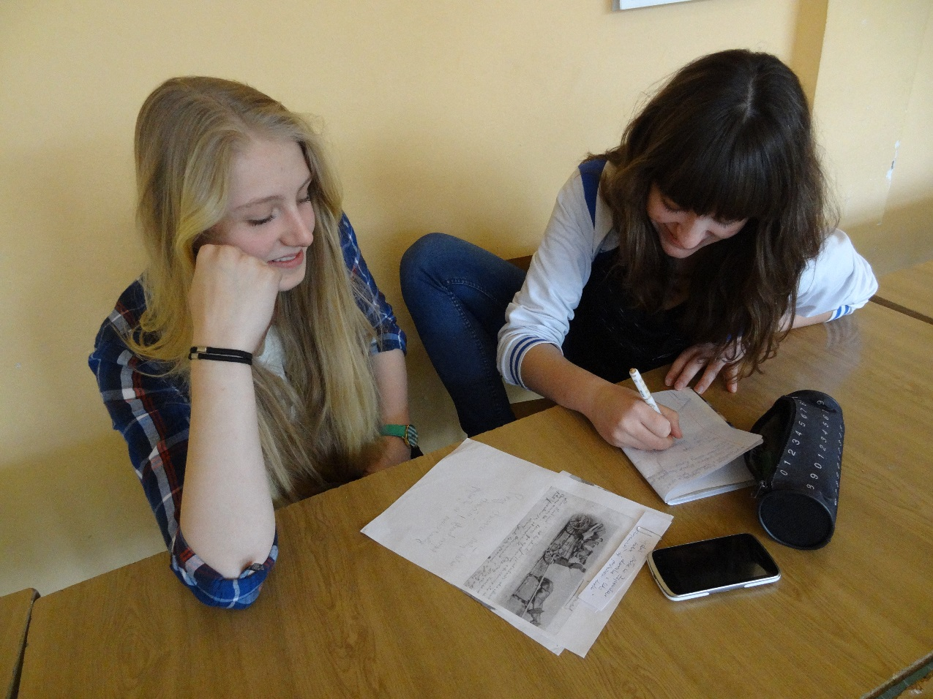
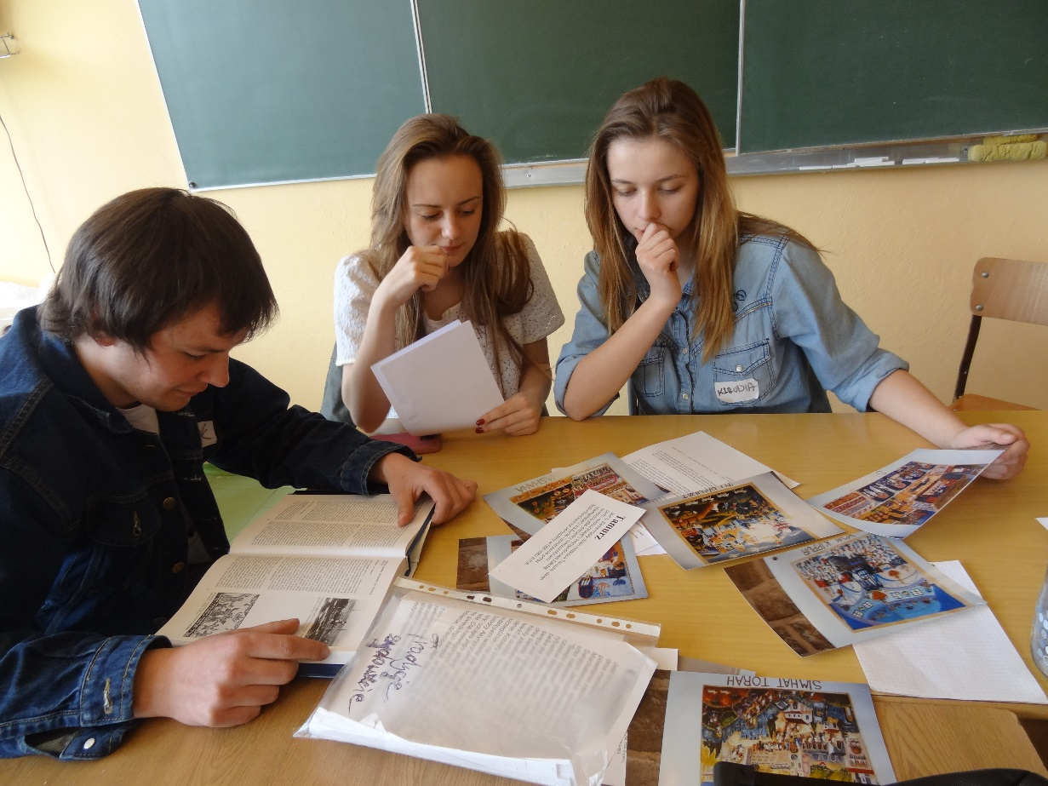
Results of our investigations – theresources: No knowledge about the fact that the former headmaster of our school (in the 60s and 70s of the 20th century) was awarded a medal of the Righteous Among the Nations or interesting way of commemoration of this event

Slide 4
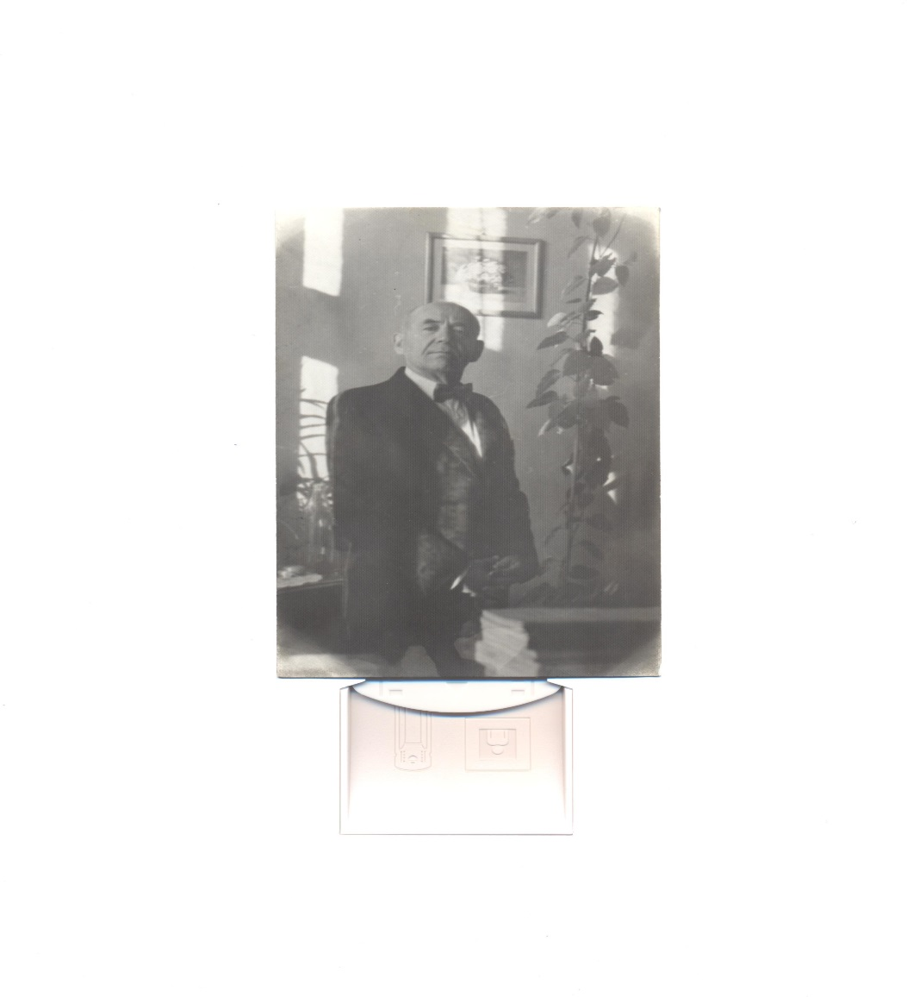
Jan Michał Langiewicz the former headmaster of LO im. S. Żeromskiego [in the 60s and 70s of the 20th century] – was awarded a medal of the Righteous Among the Nations

Slide 5
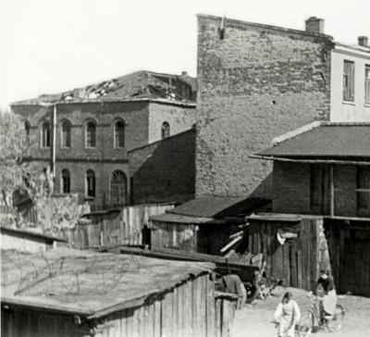
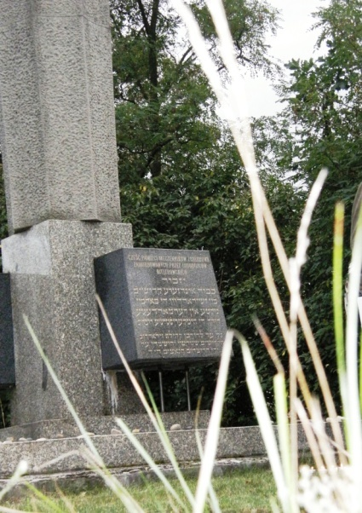
Little or no knowledge of pre-war and wartime history of Jews rescued by Poles during World War II in our locality – no serious attention to memorials, no awareness of their existence

Slide 6
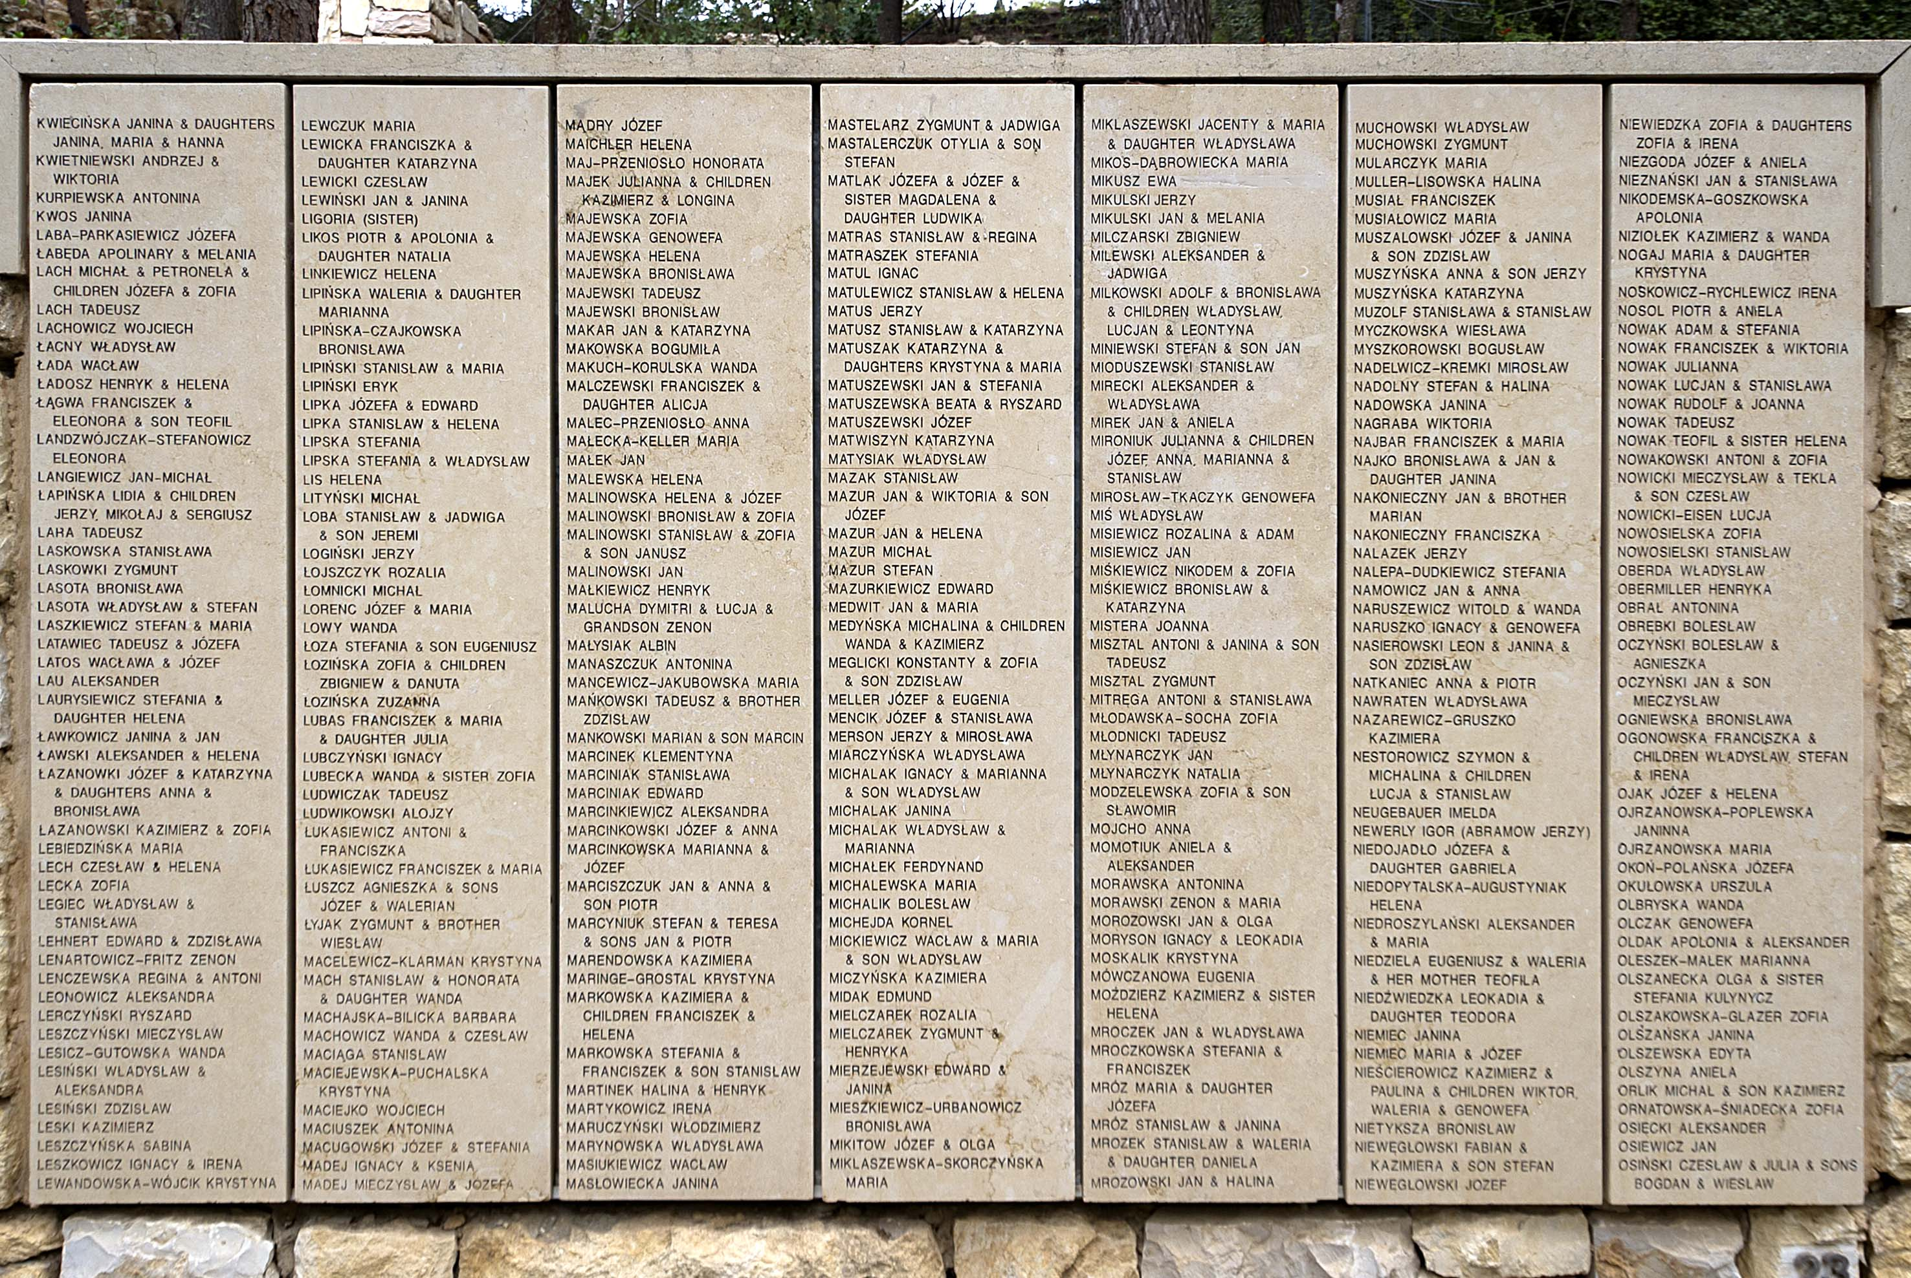
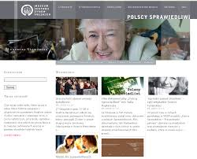
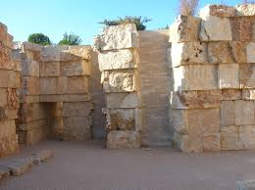
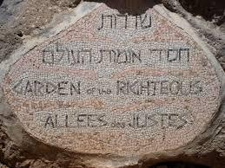
It’s clear where to find sources of knowledge about the Medal of the Righteous among the Nations

Slide 7
There are enthusiasts of local heritage protection and its commemoration at school and in the local community, as well as people working for cultural institutions or members of local associations that may assist students in their activities or be their recipients.

Slide 8
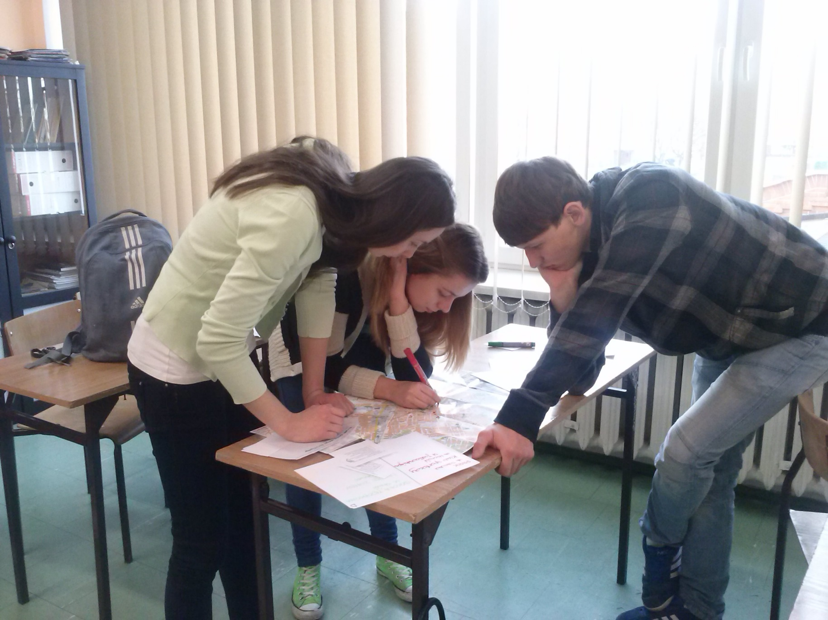
We have found unknown symbolic places in Żyrardów that can be placed on the walking route Forgotten Traces

Slide 9
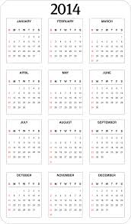
We know sources of knowledge of the unknown pre-war and wartime history of Jews rescued by Poles during World War II in our locality
The headmistress agrees on the planned activities and their schedule
We are going to publish information about our activities in local media (Tydzień Żyrardowa, Murowane Klimaty) and on the school website.

Slide 10
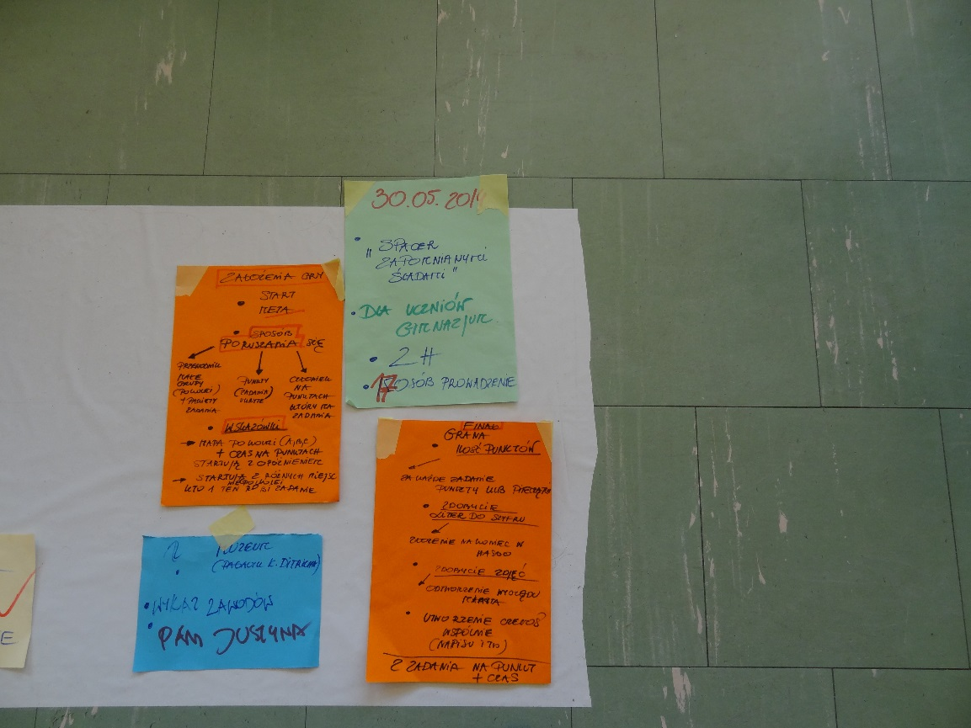
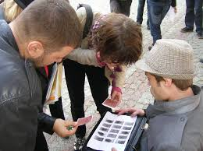
In the school resources, we have publications on the principles of development of urban games
A city game Following forgotten traces with the culminating event – an installation on the railway platform in Żyrardów ... [Who were the Rescued during World War II? The local history of the Jewish community. (30th of May 2014)

Slide 11
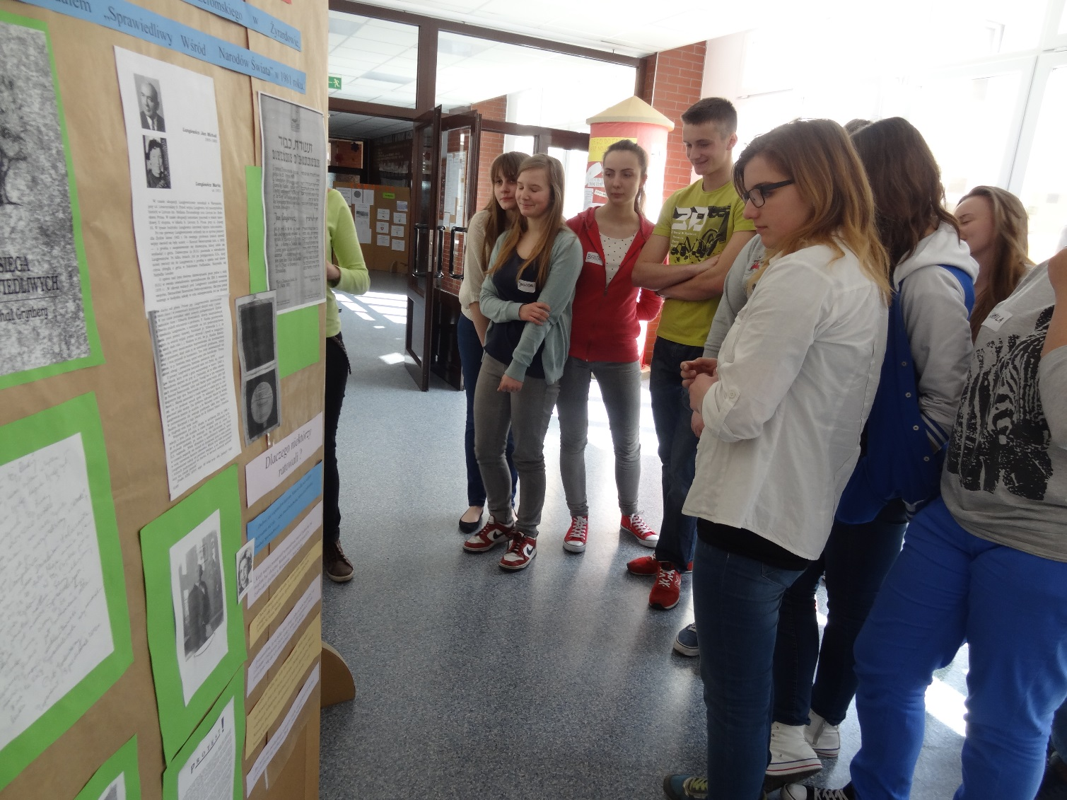
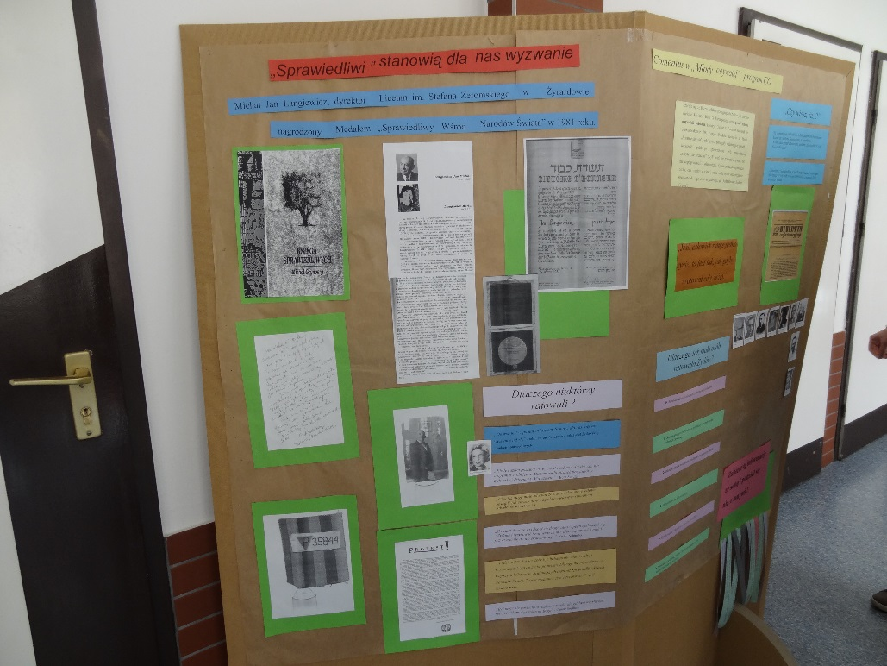
Schedule of activities
Preparing (at school) an exhibition containing information on the fact that the former headmaster of our school [in the 60s and 70s] was awarded a medal of the Righteous Among the Nations and also information on the special significance of the medal - [last week of March];

Slide 12
2nd thematic exhibition "The Righteous", that is "Who?"- In what circumstances did the Righteous rescue Jews? What helped them to do this? And what did they risk? What obstacles did they encounter? [2nd week of April]
An action for the promotion of a meeting entitled Why should the Righteous be remembered? – commemoration of Jan Michał Langiewicz as the winner of the Medal of the Righteous Among the Nations [1st – 2nd week of April]

Slide 13
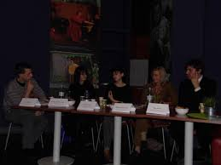
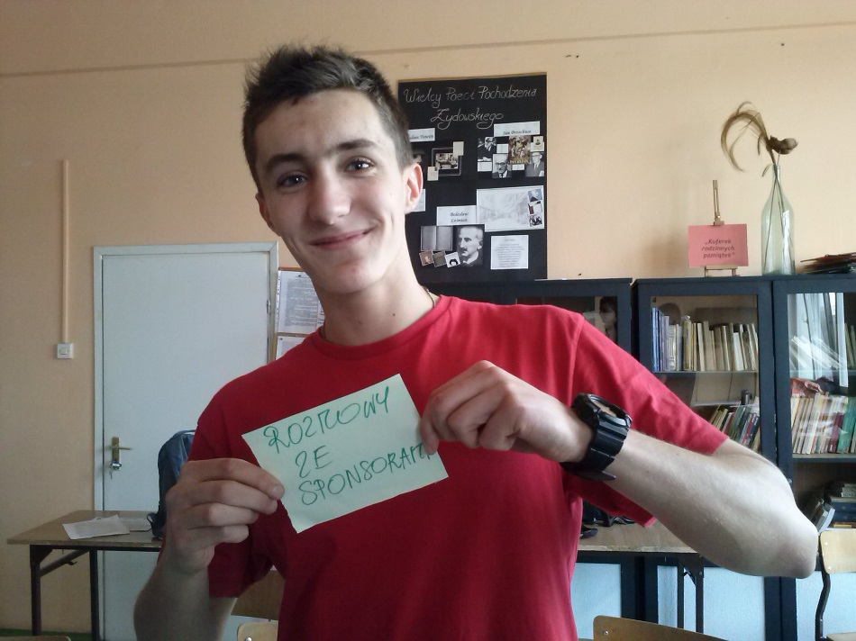
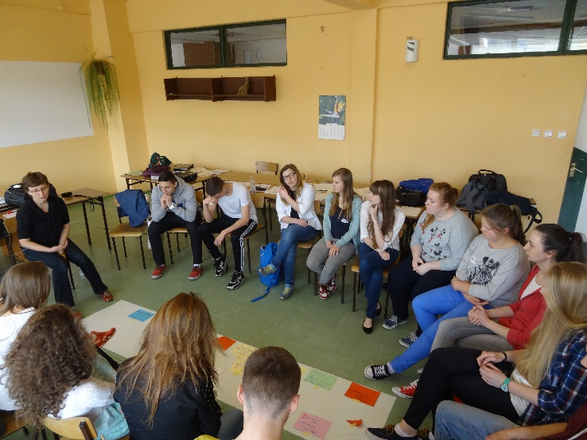
A meeting entitled Why should the Righteous be remembered? (with the participation of a chosen class, interested students, guest invited from outside the school)
An action for the promotion of a city game Following forgotten traces – (two first weeks of May)

Slide 14
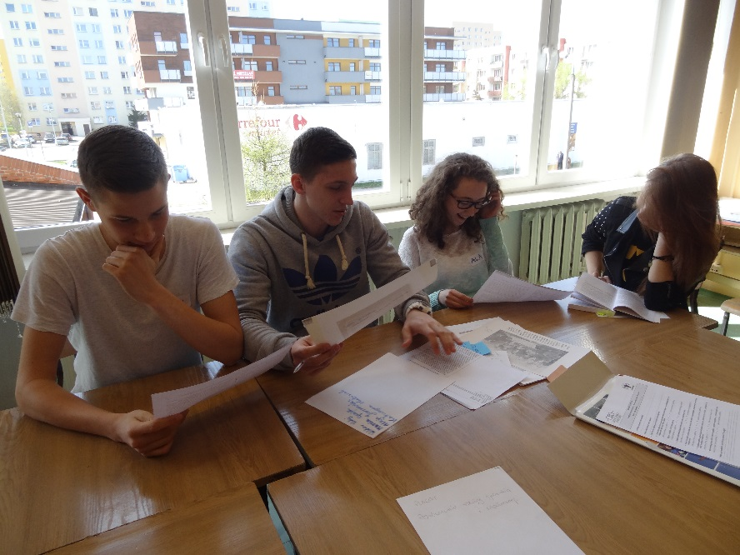
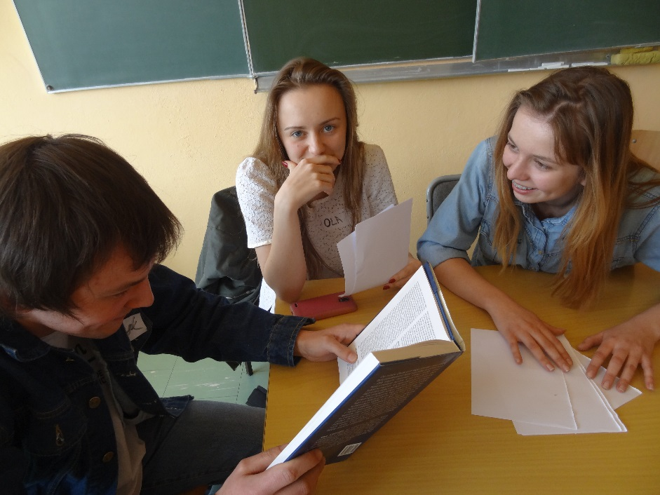
We are creating the concept of a city game How to reconstruct selected themes from the history of life of the Jewish community in pre-war and war Żyrardów on the basis of the set of inspiring materials we have?
Types of inspiring materials – we have photos, letters, memories, documents, drawings, articles ...

Slide 15
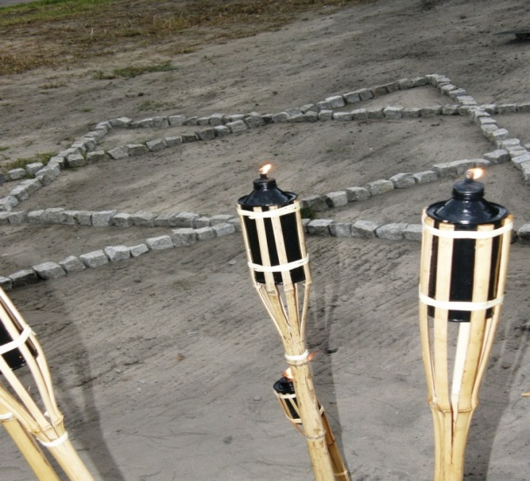
Examples of questions of city game:
What can we use to restore the knowledge about the life of the Jewish community living in Żyrardów before and during World War II [what tradition did the Jews have to preserve the memory of their lives in different places of the world? - [from excerpts from yizkor books?
What did the Jewish inhabitants of our city look like and what does that say about them? (from photos)?
What did Jews from Żyrardów do on a daily basis? (from a list of service providers present in the pre-war Żyrardow)?
What famous Jews should we remember? (from memories of Daniel Wagner) ?
What object was very important for the Jewish community in Żyrardow and what do we know about its appearance and function [from a drawing and a photo of a synagogue and information about the functions of the synagogue from an encyclopedia?
What was the education of Jews in Żyrardów like? (from fragments of an article and information from a Museum of Western Mazovia webpage) ?…….
And.. What message regarding the obligation to remember the Holocaust can we create during our walk?

Slide 16
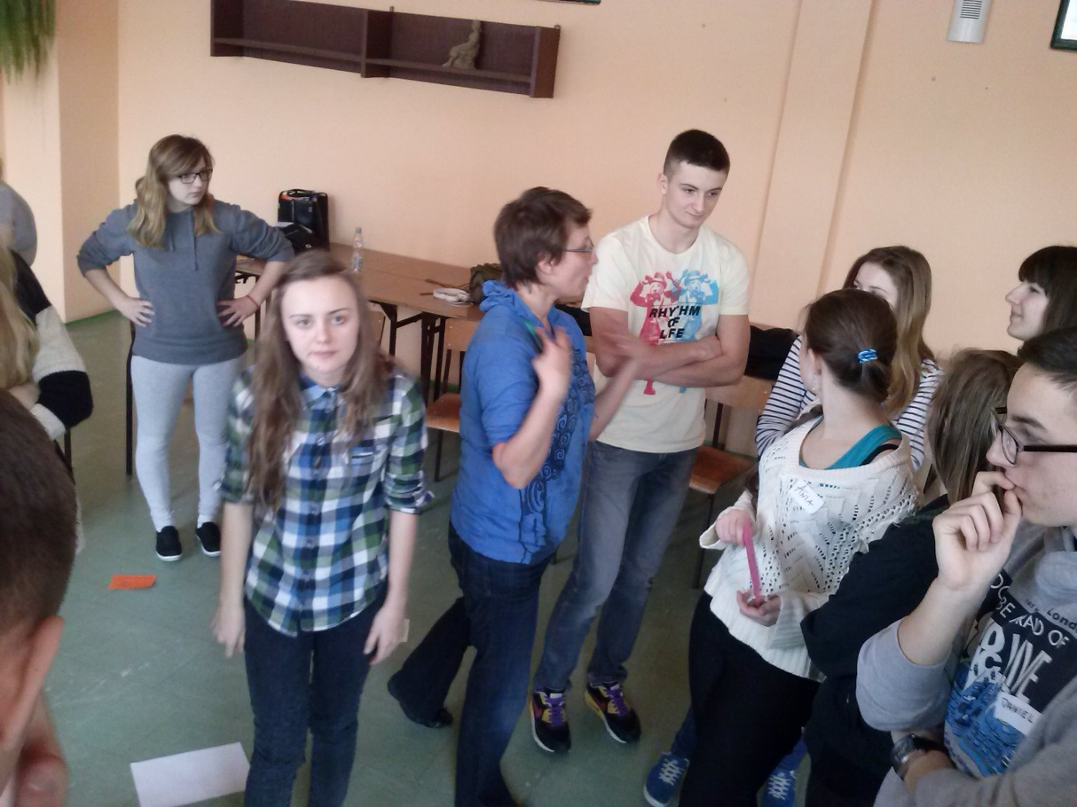
July 2014
Participation in a training camp for youth leaders
[recruitment organised by the Centre for Civic Education]!

