Slide 1
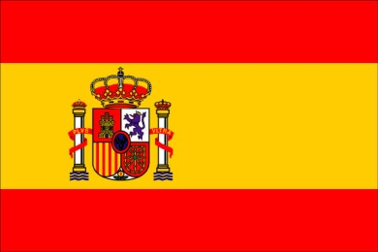
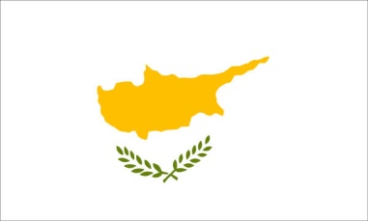
Social capital in our communities and activities to improve it Joint report
The work on social capital in our communities is particularly important during the two years of our Comenius project because it completes the program and it highlights several aspects :
- These works on social capital have lasted long, requiring several steps over several months: a period of reflection and research around the local social capital, a phase of involvement of students who went to meet associations or seeking solutions to improve social capital, a phase of presentation and exchange between partners during two mobilities in France and Poland.
- The scope of activities was great, as their impact beyond the context of schools, including the social fabric and territorial actors more dynamically. All partner countries have obviously been involved.
- Finally, the extent of educational issues and the qualitative leap that takes the project are noteworthy. Indeed, after two years of the project, after discussing the theoretical problems of human rights , discrimination related to gender, the persistence of gender stereotypes, students are now asked to invest empirically as active citizens at the heart of their city, participating in improving the social capital. It is indeed a concrete citizen learning through better knowledge of social resources in their territory, research and if possible the implementation of practical solutions to problems, participation in local civic projects...
Here are all the work and activities put forward by each partner school: (click on the flags)

Slide 2
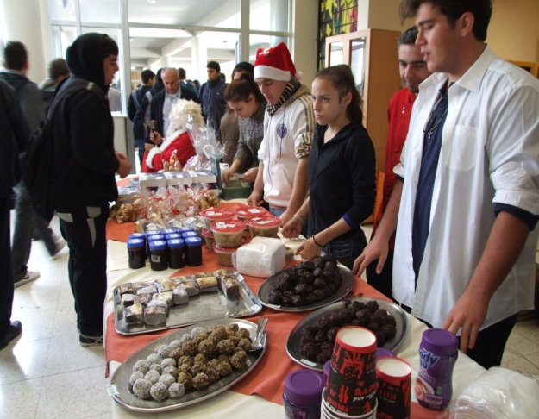
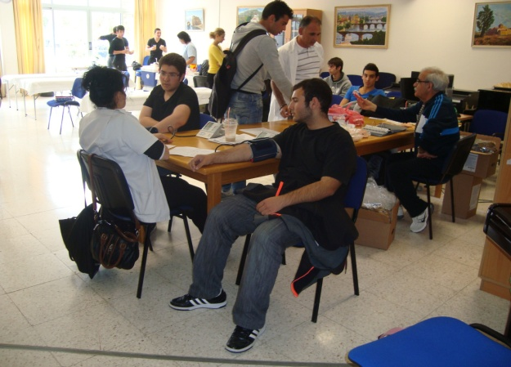
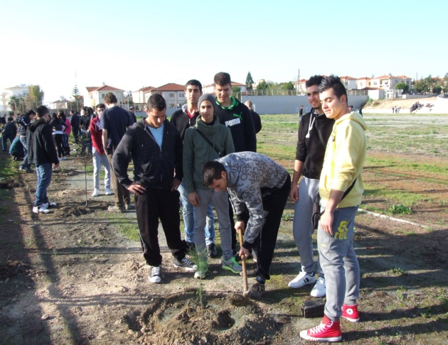
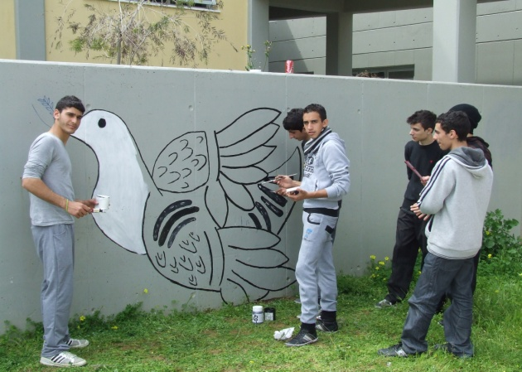
Cyprus:
Many actions and activities have been carried out in favor of social capital in the school environment:
 Communication about participation in an artistic event to promote European cooperation day (achievement by students in a mural at the Larnaca International Airport.)
 Landscaping of school buildings (production by students of graffiti inspired by the values ​​of peace in particular.)
 Blood donation.
Planting 180 trees outside the school premises (action for the environment).
Organization of campaign donations of food and commodities (" love packages ") to the poor, to fight against the effects of the economic crisis.
 Actions taken by volunteer students from electricity section towards the poor families of the community (repairing electrical problems in homes...)
 Organizing a charity event, " Christmas Bazaar " selling items created by students (furniture, clothing, fashion, decoration , cakes ) has provided financial assistance to students in need.

Slide 3
Social capital in our communities and activities to improve it Joint report
The work on social capital in our communities is particularly important during the two years of our Comenius project because it completes the program and it highlights several aspects :
- These works on social capital have lasted long, requiring several steps over several months: a period of reflection and research around the local social capital, a phase of involvement of students who went to meet associations or seeking solutions to improve social capital, a phase of presentation and exchange between partners during two mobilities in France and Poland.
- The scope of activities was great, as their impact beyond the context of schools, including the social fabric and territorial actors more dynamically. All partner countries have obviously been involved.
- Finally, the extent of educational issues and the qualitative leap that takes the project are noteworthy. Indeed, after two years of the project, after discussing the theoretical problems of human rights , discrimination related to gender, the persistence of gender stereotypes, students are now asked to invest empirically as active citizens at the heart of their city, participating in improving the social capital. It is indeed a concrete citizen learning through better knowledge of social resources in their territory, research and if possible the implementation of practical solutions to problems, participation in local civic projects...
Here are all the work and activities put forward by each partner school: (click on the flags)

Slide 4
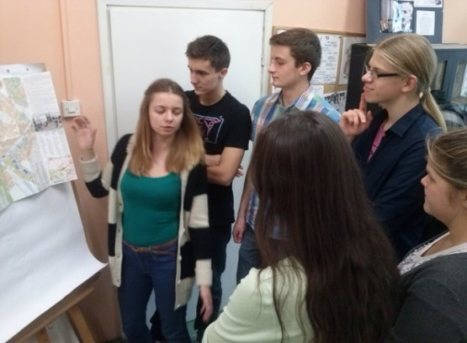
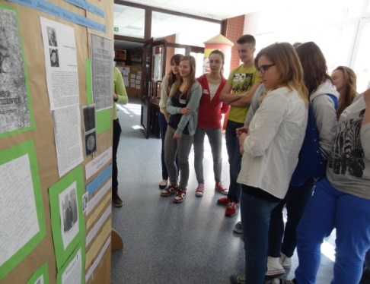
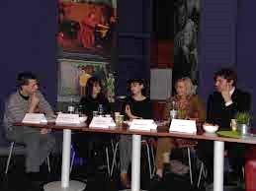
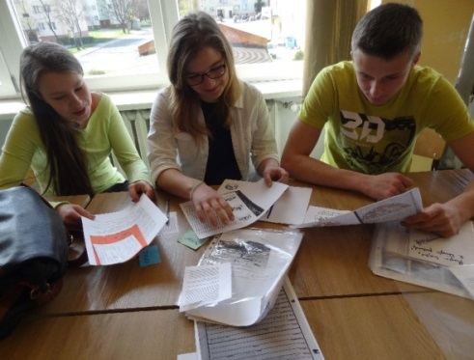
Poland:
Within the framework of the program "young people" of the Centre for Civic Education, students led a project to enhance the heritage of Żyrardów in permanent link with institutions, associations and players of local social capital. They worked to restore the memory of the Jewish community Żyrardów before and during World War II, and the commemoration of the “Righteous Among the Nations” among which is the first director of the school. The students followed a rigorous approach to meet the goals they have set and build step by step a large project including the following major stages:
 Exploration of the capital city to uncover needs and decide on a focus for the project. Census of institutions of the city, interview of members who work there.
 Finding and identifying a need: lack of tribute to deserving individuals in the history of the city, especially the first headmaster, Professor Michael Langiewicz, who received the medal of the “Righteous among the Nations” for saving Jews during the Second World War. There is little or no knowledge of the community on the history of Jews before and during the war.
 Preparation of a draft "fair, a challenge for us." Objectives and means: the desire to restore the past, to go in search of forgotten footsteps, satisfy a duty of memory. Design a commemorative trail in the city, developing a City game.
 Finding Help and information from institutions and local associations: the Polish Society of Tourism, Museum of Western Mazovia, the Society of Friends of Żyrardów (meeting of members, interviews)...
 Collecting forgotten traces: documents, letters, souvenirs, photos, drawings... rediscovery and identification of known and symbolic places of the history of Jews in Żyrardów to design a memorial trail.
 Publishing and media coverage of actions and outcomes (local newspaper, school website ...)
Organizing and promoting events: two exhibitions at school (about the former director and the theme of the Righteous), open to students and people from outside the school meeting.
Creation, promotion and organization of a City game, from the materials collected.
 Participation in a training camp for young leaders, organized by the Centre for Civic Education.
Different worhops about forgotten traces…
A meeting around the question : Why should the righteous be remembered ?
Workshop about the creation of a city game

Slide 5
Social capital in our communities and activities to improve it Joint report
The work on social capital in our communities is particularly important during the two years of our Comenius project because it completes the program and it highlights several aspects :
- These works on social capital have lasted long, requiring several steps over several months: a period of reflection and research around the local social capital, a phase of involvement of students who went to meet associations or seeking solutions to improve social capital, a phase of presentation and exchange between partners during two mobilities in France and Poland.
- The scope of activities was great, as their impact beyond the context of schools, including the social fabric and territorial actors more dynamically. All partner countries have obviously been involved.
- Finally, the extent of educational issues and the qualitative leap that takes the project are noteworthy. Indeed, after two years of the project, after discussing the theoretical problems of human rights , discrimination related to gender, the persistence of gender stereotypes, students are now asked to invest empirically as active citizens at the heart of their city, participating in improving the social capital. It is indeed a concrete citizen learning through better knowledge of social resources in their territory, research and if possible the implementation of practical solutions to problems, participation in local civic projects...
Here are all the work and activities put forward by each partner school: (click on the flags)

Slide 6
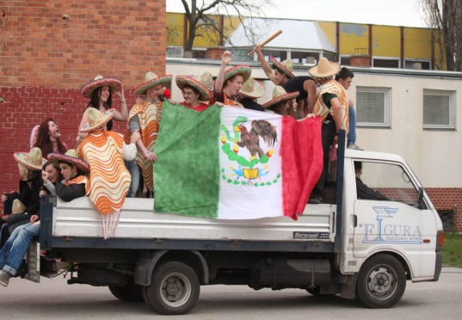
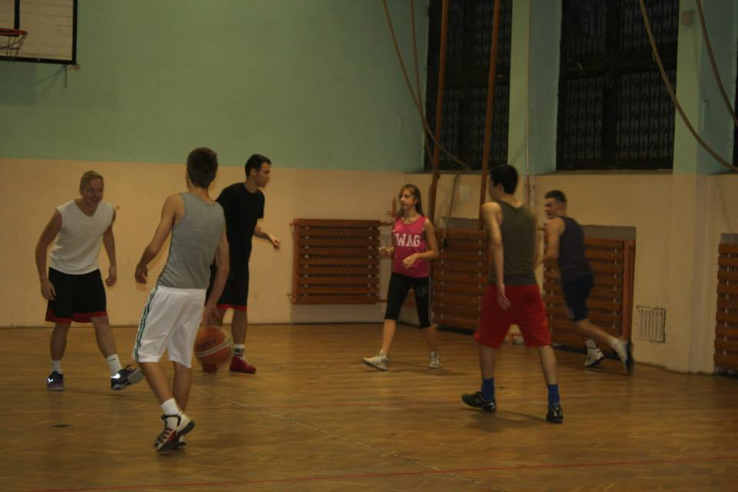
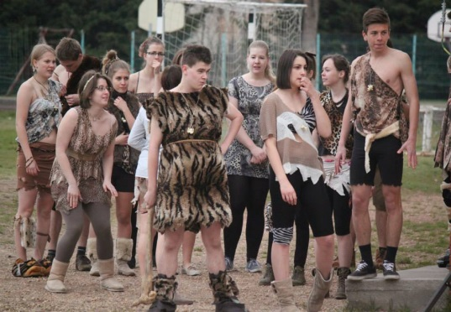
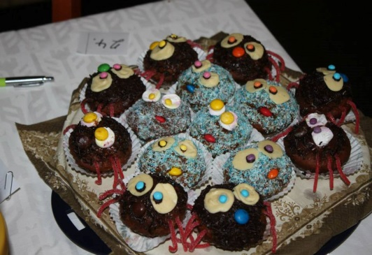
Hungary:
Condition: in the 17th district of Budapest six popular associations exist with the aim to help people who are in need for example to:
Aranyhegy Association seeks to develop and make the area more beautiful, protecting the environment, animals, cultural heritage, organizing sports events and exhibitions...
 Folk Art Association of Rákosmente acts to maintain the popular arts and traditions, supporting artists, organizing exhibitions...
 The Young for Rákosmente Association founded in 2009 by young people over 20 organizes cultural events, celebrations, social and charitable activities to improve the quality of life...
Here are the actions to improve the social capital that the school attended:
 Creation of a Facebook group to facilitate the speedy provision and cheap textbooks. They also aim at linking members of the educational community and at communicating about important festive events of the school, such as Student Council Day, the tournament 24 basketball, Halloween...  Completion of 50 hours of community service to help others (in kindergartens, retirement homes, libraries...) under a new law in Hungary.
Students propose some ideas to further improve the capital:
 Helping those who pass their examination by providing on various documents and information on Facebook...
 Create a Facebook group for bookworms, so they can exchange their books and reviews, and thoughts on the film adaptations...
 Create a link between students and associations, organizing meetings with teachers from other schools and with the people responsible for organizing community work, creating a website to spread information...
24 hours Basketball
Student Council Day
Halloween

Slide 7
Social capital in our communities and activities to improve it Joint report
The work on social capital in our communities is particularly important during the two years of our Comenius project because it completes the program and it highlights several aspects :
- These works on social capital have lasted long, requiring several steps over several months: a period of reflection and research around the local social capital, a phase of involvement of students who went to meet associations or seeking solutions to improve social capital, a phase of presentation and exchange between partners during two mobilities in France and Poland.
- The scope of activities was great, as their impact beyond the context of schools, including the social fabric and territorial actors more dynamically. All partner countries have obviously been involved.
- Finally, the extent of educational issues and the qualitative leap that takes the project are noteworthy. Indeed, after two years of the project, after discussing the theoretical problems of human rights , discrimination related to gender, the persistence of gender stereotypes, students are now asked to invest empirically as active citizens at the heart of their city, participating in improving the social capital. It is indeed a concrete citizen learning through better knowledge of social resources in their territory, research and if possible the implementation of practical solutions to problems, participation in local civic projects...
Here are all the work and activities put forward by each partner school: (click on the flags)

Slide 8
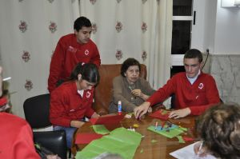
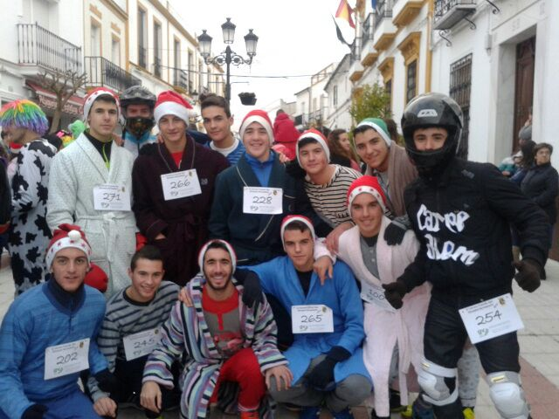
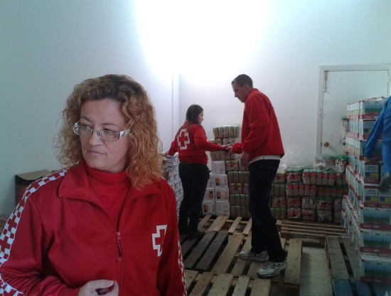
Spain:
Condition: in the village of Monesterio, students identified and listed on a map the various places where people can help those who have economic problems because of the crisis. Both associations have caught their attention:
 Caritas Spain: it is an organization of the Catholic Church established in 1980 that helps families in need, whose number is increasing (50 families currently in Monesterio.) Caritas Spain receives contributions from its members, and distributes the money to pay for electricity, medicines and rent. Caritas also collects food to create a food bank. The Maestro Juan Calero School helped Caritas collecting food and hygiene products: students go around every house annually.
 Cruz Roja (the International Movement of the Red Cross). Students interviewed the director of the Youth Red Cross in Monesterio. They chose to work with the Red Cross, because it organizes many activities to help the elderly, the sick, children and teenagers by distributing food, health care, and toys for Christmas ... in addition, some students are unpaid volunteers in the Red Cross. Thus, they decided to participate in the race solidarity held every Christmas Eve by the school: with their gym teacher, they ran through the village wearing a Christmas hat, and carrying food, which was then given to the Red Cross. Students want to repeat the very rewarding experience in the coming years.
Students at the main entrance of Caritas
Classmates collaborating with Cruz Roja
Solidarity Run
Volonteers in the delivery of food

Slide 9
Social capital in our communities and activities to improve it Joint report
The work on social capital in our communities is particularly important during the two years of our Comenius project because it completes the program and it highlights several aspects :
- These works on social capital have lasted long, requiring several steps over several months: a period of reflection and research around the local social capital, a phase of involvement of students who went to meet associations or seeking solutions to improve social capital, a phase of presentation and exchange between partners during two mobilities in France and Poland.
- The scope of activities was great, as their impact beyond the context of schools, including the social fabric and territorial actors more dynamically. All partner countries have obviously been involved.
- Finally, the extent of educational issues and the qualitative leap that takes the project are noteworthy. Indeed, after two years of the project, after discussing the theoretical problems of human rights , discrimination related to gender, the persistence of gender stereotypes, students are now asked to invest empirically as active citizens at the heart of their city, participating in improving the social capital. It is indeed a concrete citizen learning through better knowledge of social resources in their territory, research and if possible the implementation of practical solutions to problems, participation in local civic projects...
Here are all the work and activities put forward by each partner school: (click on the flags)

Slide 10
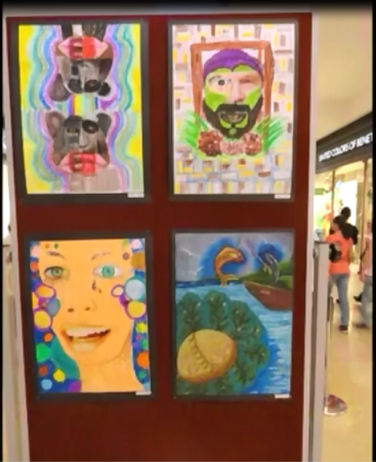
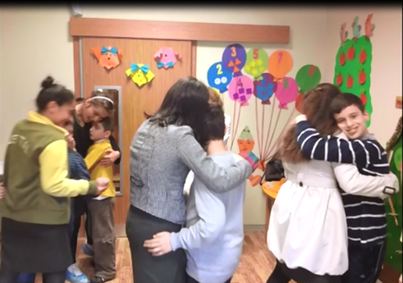
Turkey:
Students and teachers presented their work for the improvement of local social capital in the context of learning social solidarity. They made ​​two films exposing their ideas and actions to strengthen the link between generations, between children, parents and grandparents. These materials, in English, helped students to improve their foreign language skills.
 First of all, in the form of interview, the students were invited to wonder about the importance of these intergenerational links for community cohesion. They stressed the importance of mutual exchange in which everyone had to learn from each other. Thus, each student said what he could do personally or with others to improve social capital: some of them planning to get even closer to their parents or grandparents, for example by providing them with computer skills, or drawing on the experience of elderly life lessons. Others have proposed to focus more on children of a kindergarten nearby. Another example, some of them thought organize an event in the future at school to raise money which would then be given to the poor families of the city. Others have imagined to meet sick children at the hospital to relieve some of their suffering and loneliness.
 An art exhibition has helped raise funds for the charity activities of the school.
Another important step was the organization of a visit by students and their teachers of an educational center for autistic children, located 15 km from the city center. The preparation of this event brought together toys that students themselves packed to make gifts. When visiting the center, students have spent a whole afternoon with autistic children, multiplying the activities: they played, danced, drew, took pictures with them, held them in their arms... of course the distribution of gifts was an appreciated moment.
Students have learned a lot from those experiences: they kept positive impressions and the idea of ​​building a better world through solidarity as evidenced by positive messages and slogans that punctuate the film.
Art exhibition
Visiting an educational center for autistic children

Slide 11
Social capital in our communities and activities to improve it Joint report
The work on social capital in our communities is particularly important during the two years of our Comenius project because it completes the program and it highlights several aspects :
- These works on social capital have lasted long, requiring several steps over several months: a period of reflection and research around the local social capital, a phase of involvement of students who went to meet associations or seeking solutions to improve social capital, a phase of presentation and exchange between partners during two mobilities in France and Poland.
- The scope of activities was great, as their impact beyond the context of schools, including the social fabric and territorial actors more dynamically. All partner countries have obviously been involved.
- Finally, the extent of educational issues and the qualitative leap that takes the project are noteworthy. Indeed, after two years of the project, after discussing the theoretical problems of human rights , discrimination related to gender, the persistence of gender stereotypes, students are now asked to invest empirically as active citizens at the heart of their city, participating in improving the social capital. It is indeed a concrete citizen learning through better knowledge of social resources in their territory, research and if possible the implementation of practical solutions to problems, participation in local civic projects...
Here are all the work and activities put forward by each partner school: (click on the flags)

Slide 12
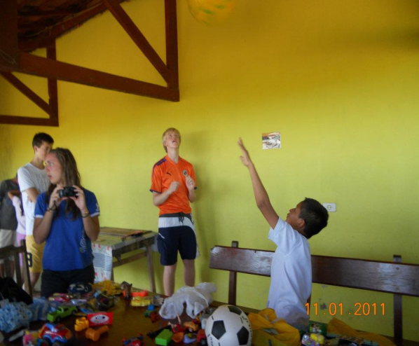
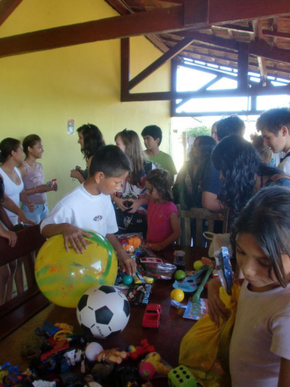
Iceland:
The students wanted to highlight two representative local social capital Icelandic associations, and shared one experience of volunteering abroad.
 Á allra Vorum (On Everyone’s Lips) is a charity founded in 2008 by three women. Its originality lies in the fact that each year, one particular cause is chosen and the whole nation (individual and corporate sponsors) is invited to make donations in its favor: for example fundraising allowed the purchase of a new mammography for the cancer Institute in 2008, the funding of a recreation home for children with cancer in 2009, the purchase of a new echocardiography machine for sick children in 2011... Donations can be made by internet.
 Konukot is a shelter for homeless women, alcoholics and drug addicts, created in 2004 by the Red Cross and the City of Reykjavik. The center is open from 5 pm to 11 am every day to provide food, shelter, clothing and shower. It also makes prevention by distributing clean needles, condoms and advice to drug users.
 Volunteer experience: Visiting an orphanage in Brazil. One student shared his experience as part of a trip to Brazil, the Pantanal and Bonito region, with the organization AFS. He was able to report on actions taken by the staff of the orphanage for children who can find food, toys and a minimum instruction.
Visiting an orphanage in Brazil

Slide 13
Social capital in our communities and activities to improve it Joint report
The work on social capital in our communities is particularly important during the two years of our Comenius project because it completes the program and it highlights several aspects :
- These works on social capital have lasted long, requiring several steps over several months: a period of reflection and research around the local social capital, a phase of involvement of students who went to meet associations or seeking solutions to improve social capital, a phase of presentation and exchange between partners during two mobilities in France and Poland.
- The scope of activities was great, as their impact beyond the context of schools, including the social fabric and territorial actors more dynamically. All partner countries have obviously been involved.
- Finally, the extent of educational issues and the qualitative leap that takes the project are noteworthy. Indeed, after two years of the project, after discussing the theoretical problems of human rights , discrimination related to gender, the persistence of gender stereotypes, students are now asked to invest empirically as active citizens at the heart of their city, participating in improving the social capital. It is indeed a concrete citizen learning through better knowledge of social resources in their territory, research and if possible the implementation of practical solutions to problems, participation in local civic projects...
Here are all the work and activities put forward by each partner school: (click on the flags)

Slide 14
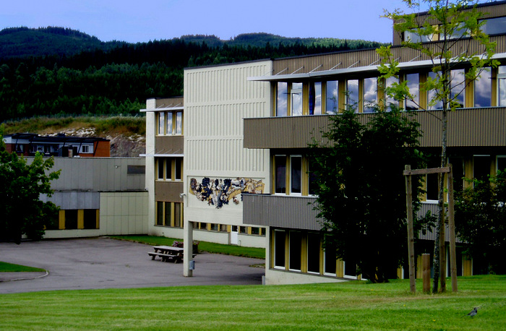
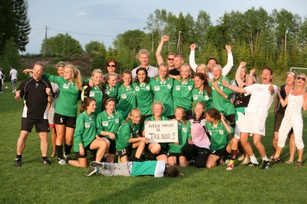
Norway:
A survey on social capital in the community :
By exploring the social capital in Nittedal which has 22000 inhabitants, and inside the school which counts 600 people, students wanted to focus on social workers, recreational and leisure venues, especially around sports.
The survey involved 100 students, and showed that social capital for young people lies in contact with social workers, friendly relations and activities around social networks. It also revealed that many young people do not belong to a club, the activities concerned only sport, music and clubs for Christians…
From these results, the students made proposals to improve the social capital of their communities through three axes:
- Create more sports clubs
- Organize meetings
- Spread information through the school.

Slide 15
Social capital in our communities and activities to improve it Joint report
The work on social capital in our communities is particularly important during the two years of our Comenius project because it completes the program and it highlights several aspects :
- These works on social capital have lasted long, requiring several steps over several months: a period of reflection and research around the local social capital, a phase of involvement of students who went to meet associations or seeking solutions to improve social capital, a phase of presentation and exchange between partners during two mobilities in France and Poland.
- The scope of activities was great, as their impact beyond the context of schools, including the social fabric and territorial actors more dynamically. All partner countries have obviously been involved.
- Finally, the extent of educational issues and the qualitative leap that takes the project are noteworthy. Indeed, after two years of the project, after discussing the theoretical problems of human rights , discrimination related to gender, the persistence of gender stereotypes, students are now asked to invest empirically as active citizens at the heart of their city, participating in improving the social capital. It is indeed a concrete citizen learning through better knowledge of social resources in their territory, research and if possible the implementation of practical solutions to problems, participation in local civic projects...
Here are all the work and activities put forward by each partner school: (click on the flags)

Slide 16
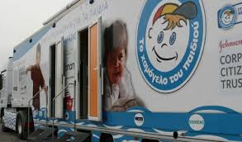
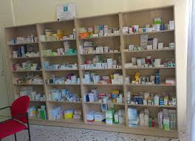
Greece:
The hardness of the current economic crisis in Greece pushes people to find solutions and take initiatives to help citizens in need.
Students were able to highlight these new forms of solidarity that are implemented in their community, for example:
 Consumers participate spontaneously in collections in supermarkets during everyday purchases: purchased products are left in the supermarket to be distributed to needy families.
 Teachers give their time after school to help students who cannot afford a tutor.
 During the Christmas and Easter holidays, students organized collections of food, toys and money.
These grants are intended institutions that help people in need.
 The municipality multiplies social actions: medical assistance (doctor at home, social pharmacy), social supermarket, social school, and home help for the elderly, free meals...
 Prisoners are encouraged to offer their services and assistance to the municipality in exchange for a sentence reduction.

Slide 17
Social capital in our communities and activities to improve it Joint report
The work on social capital in our communities is particularly important during the two years of our Comenius project because it completes the program and it highlights several aspects :
- These works on social capital have lasted long, requiring several steps over several months: a period of reflection and research around the local social capital, a phase of involvement of students who went to meet associations or seeking solutions to improve social capital, a phase of presentation and exchange between partners during two mobilities in France and Poland.
- The scope of activities was great, as their impact beyond the context of schools, including the social fabric and territorial actors more dynamically. All partner countries have obviously been involved.
- Finally, the extent of educational issues and the qualitative leap that takes the project are noteworthy. Indeed, after two years of the project, after discussing the theoretical problems of human rights , discrimination related to gender, the persistence of gender stereotypes, students are now asked to invest empirically as active citizens at the heart of their city, participating in improving the social capital. It is indeed a concrete citizen learning through better knowledge of social resources in their territory, research and if possible the implementation of practical solutions to problems, participation in local civic projects...
Here are all the work and activities put forward by each partner school: (click on the flags)

Slide 18
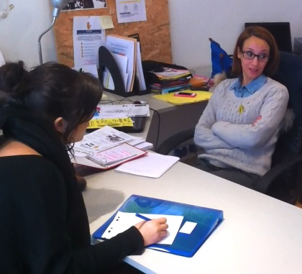
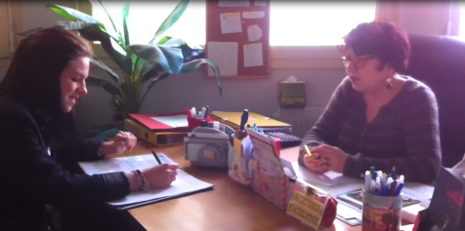
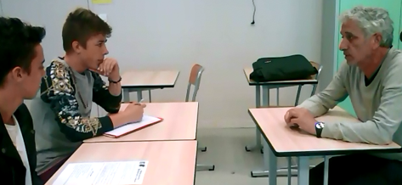
France:
 The contest of associations
At school, to work around the issue of social capital, there was a competition between several classes in civics education: the contest of associations. By participating in this game, teams have to choose a local association and advertise it. Students have to do research, conduct an interview, and if possible engage in an action with the association. A jury will select the winners, those who have gone the furthest in the project.
Here are some associations chosen by the students:
- Le Secours Populaire de Pessac (people Rescue of Pessac) provides humanitarian aid in all its forms (food, hygiene products, assistance with going on holiday, entertainment and gifts for Christmas…)
- SOS Racisme (SOS racism) fights against racism and discrimination, helping victims to gather evidence and file a complaint.
- Ni Putes Ni Soumises (Neither whores nor submissive) fights against discrimination against women, and was created with the fact that women's rights were violated by some who treat them as "whores", accusing them of putting on makeup or wearing skirts, and abusing them.
- Action Jeunesse Pessac (Youth Action of Pessac) operates on the territory of Pessac among youth in general and especially young people in difficulty.
- La LYCRA (International League against Racism and Antisemitism)
- La Maison de Simone (Simone’s home) helps women that are victim of domestic violence.
- Ciné Réseau, an association that works for cinema, by helping young artists…
 After these activities, students proposed some ideas to improve social capital :
- organizing food or clothing collection at school.
- offering assistance for an attic sale.
- Inviting members of associations at school, to organize debates…
- Promoting the associations to other students (by putting up posters…)
- organizing an event at school: the day of the associations.
Some students with associations

Slide 19
Social capital in our communities and activities to improve it Joint report
The work on social capital in our communities is particularly important during the two years of our Comenius project because it completes the program and it highlights several aspects :
- These works on social capital have lasted long, requiring several steps over several months: a period of reflection and research around the local social capital, a phase of involvement of students who went to meet associations or seeking solutions to improve social capital, a phase of presentation and exchange between partners during two mobilities in France and Poland.
- The scope of activities was great, as their impact beyond the context of schools, including the social fabric and territorial actors more dynamically. All partner countries have obviously been involved.
- Finally, the extent of educational issues and the qualitative leap that takes the project are noteworthy. Indeed, after two years of the project, after discussing the theoretical problems of human rights , discrimination related to gender, the persistence of gender stereotypes, students are now asked to invest empirically as active citizens at the heart of their city, participating in improving the social capital. It is indeed a concrete citizen learning through better knowledge of social resources in their territory, research and if possible the implementation of practical solutions to problems, participation in local civic projects...
Here are all the work and activities put forward by each partner school: (click on the flags)

