Slide 1
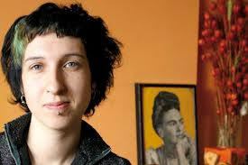
Meeting with Sylwia Chutnik in Liceum Ogólnokształcącym im. Stefana Żeromskiego in Żyrardowów 08.01.2013

Slide 2
Meeting with Sylwia Chutnik in our school was held within the Comenius project "School factory of initiatives, equal citizenship". Specifically, it was related to our participation in the International Project 16 Days of Action Against Gender-Based Violence violence based. The motto of the campaign motto was: "Women and War"

Slide 3
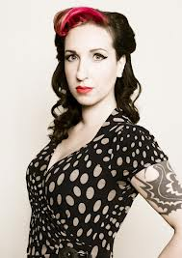
Sylwia Chutnik
A specialist in cultural studies, social activist, writer, journalist, winner of several major awards, gender
studies graduate.

Slide 4
She is the founder of the MaMa Foundation dedicated to the rights of mothers.

Slide 5
Sylwia Chutnik is a author, who is well known in the community of socially engaged writers: „Kieszonkowy atlas kobiet” (Kraków 2008) „Dzidzia” (Warszawa 2009) „Warszawa kobiet” (Warszawa 2011) „Mama ma zawsze rację” (Warszawa 2012) „Cwaniary” (Warszawa 2012)

Slide 6
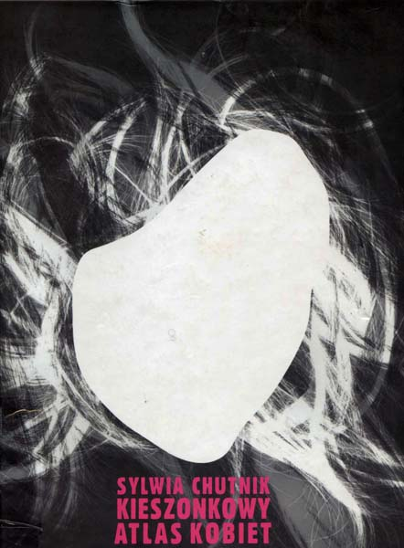
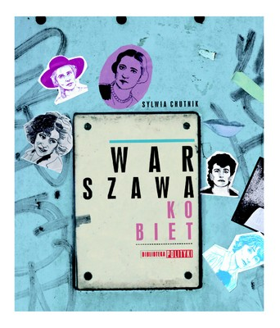

Slide 7
Mum is always right
The author describes the classic division of household roles in a slightly distorted mirror and with a big dose of irony. A Polish Mother - cleaning, father – an “armchair hunter” and "it", the apple of the family’s eye.

Slide 8
Last novel, 2012
Because of this book, the author is called "Polish Tarantino" in the reality of Warsaw

Slide 9
Warsaw as a literary hero
Warsaw of the suburbs, so-called old Warsaw and more than this, is a hero of all her books. The author loves
Warsaw and is a tourist guide to our capital.

Slide 10
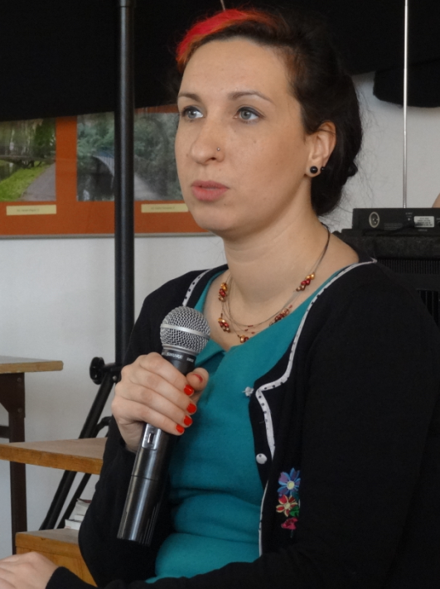
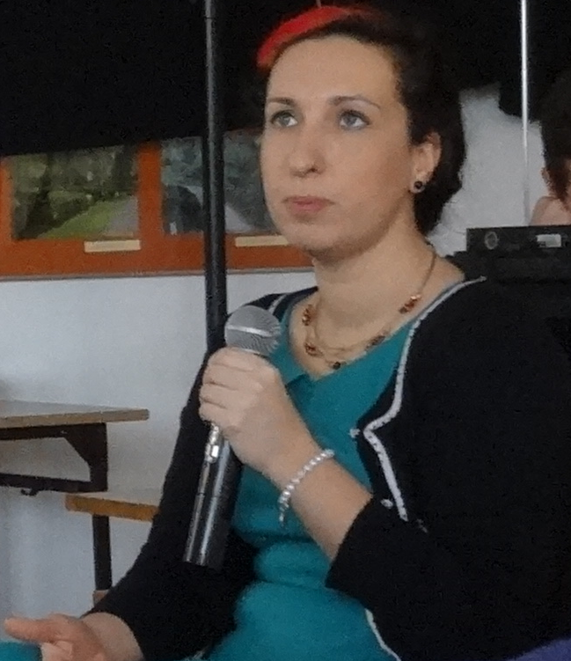

Slide 11
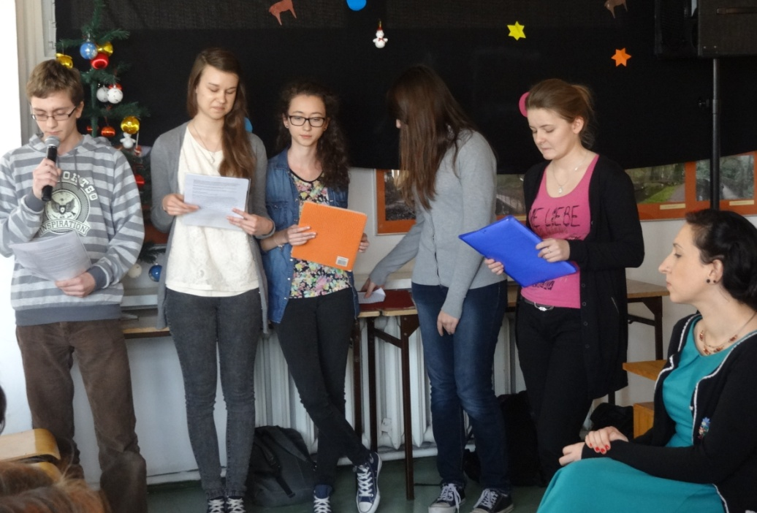
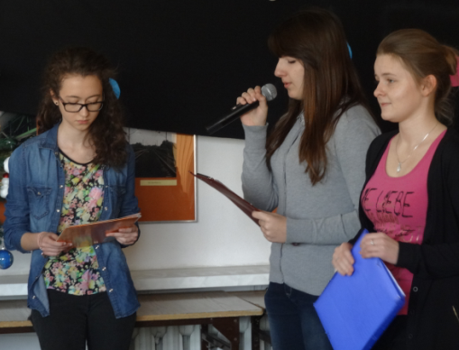
After a brief introduction, which was supposed to present Ms. Chutnik ...

Slide 12
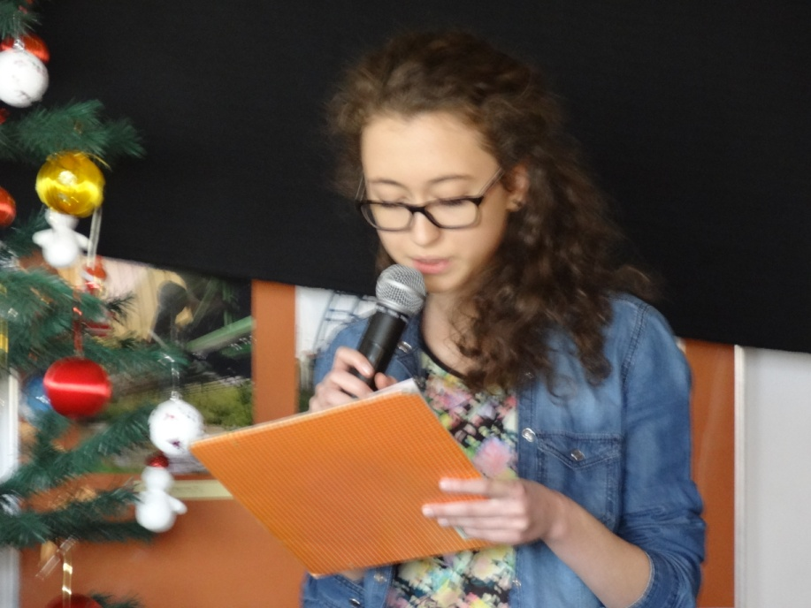
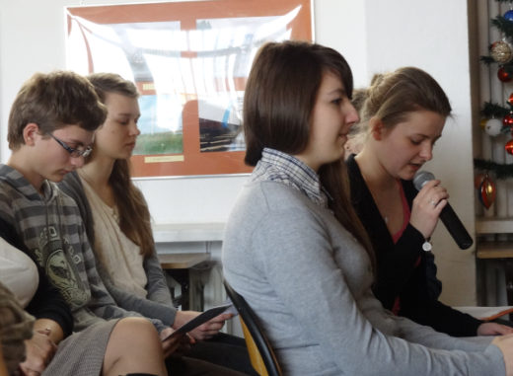
...a groups of students asked the writer a few questions about her way of writing about war ...

Slide 13
The author offers a different perspective to war than men usually offer. She tells not only about the battles fought by women, about their commanders and their battalion mates. She shows how women coped with the prose of life, with "women's issues", with fear, with death. This is not a heroic picture of war. The author in her novels strives to reconstruct emotions, feelings, thoughts that accompanied girls during wars: women hiding in basements, couriers, nurses, cryptographers, mothers and their daughters. She gives us testimony of women who participated in diversionary actions of sabotage, worked in hospitals, joined men to build barricades and to fight, and also those, who stayed in shelters, who bore children, took care for the elderly, for the children and wanted the war to be over ...

Slide 14
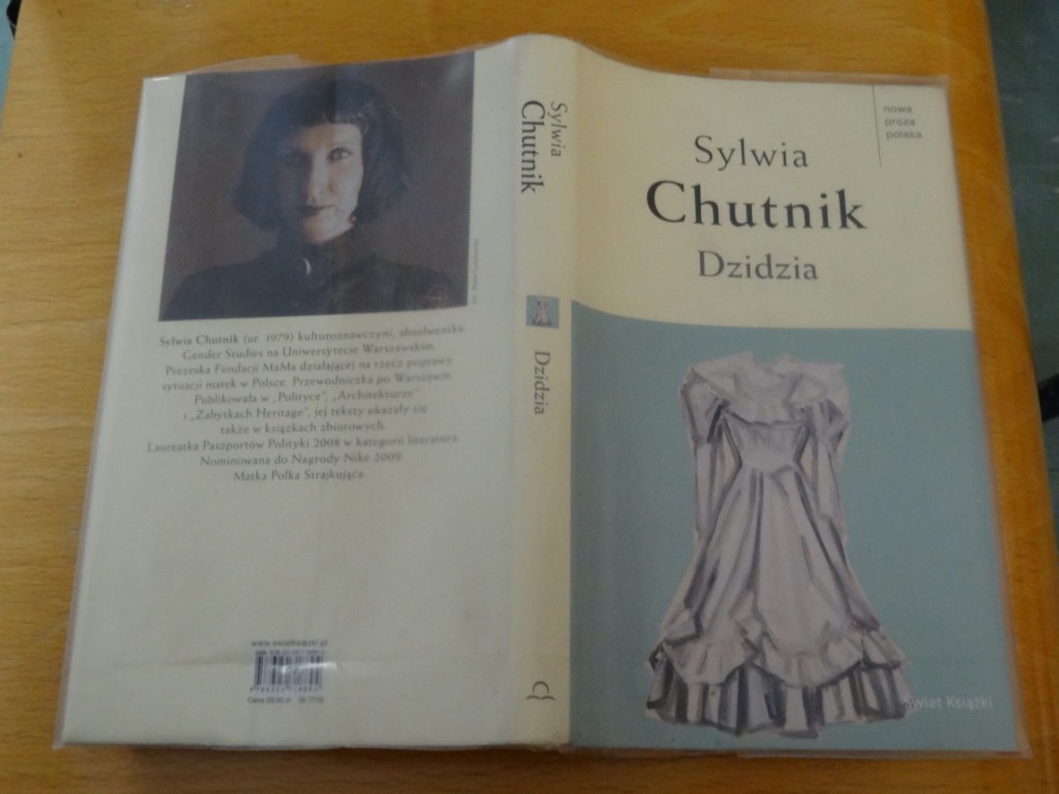
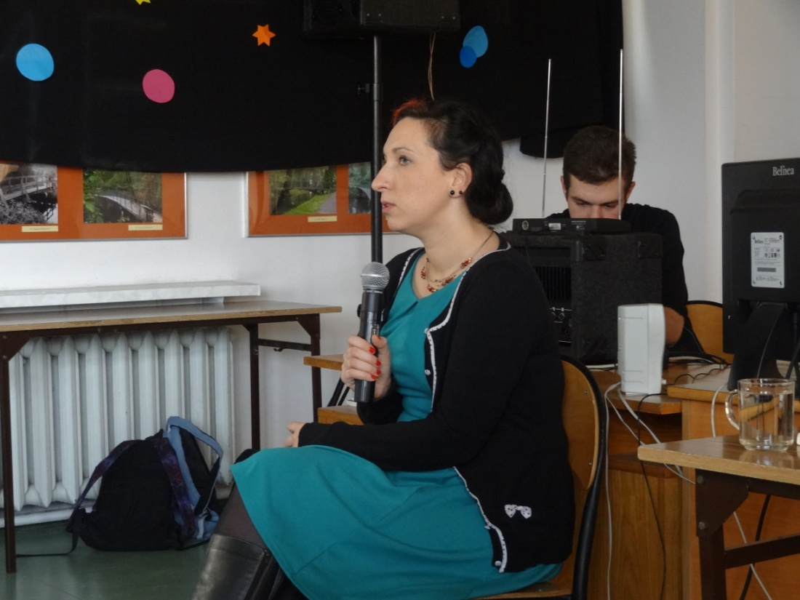
The author in a funny way talked about the origins of her interest in history and contemporary social issues, and how she knows so much about elderly people ... She noticed that very few are interested in elderly people in our society.

Slide 15
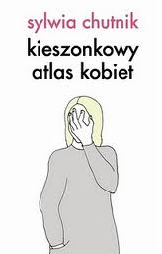
Women and war
Novels by Sylwia Chutnik are stories about the tragic fate of civilians removed from the city after the Warsaw uprising, they are also images of the destruction of the city.
The author shows that suffering of civilians is just as important and moving as suffering of fighting soldiers, and sometimes maybe the most important.
Her novels touch you with the remarkable devotion of the author and her characters to Warsaw - the extraordinary city with its tragic history

Slide 16
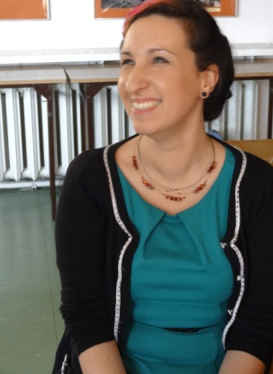
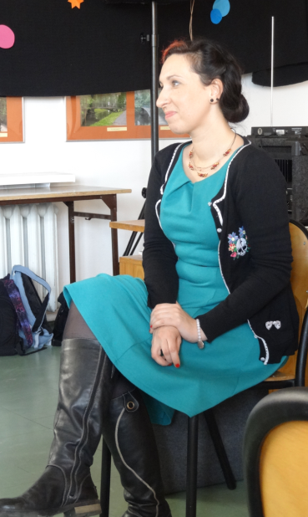
The meeting was held in a friendly atmosphere

Slide 17
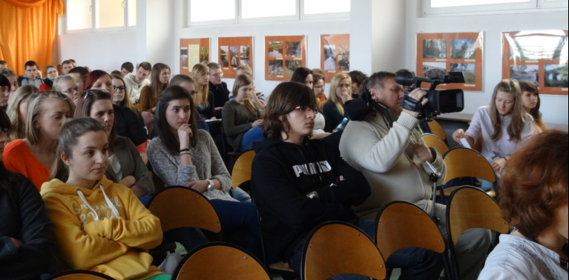
The event brought together dozens of students and also representatives of the press and local television

Slide 18
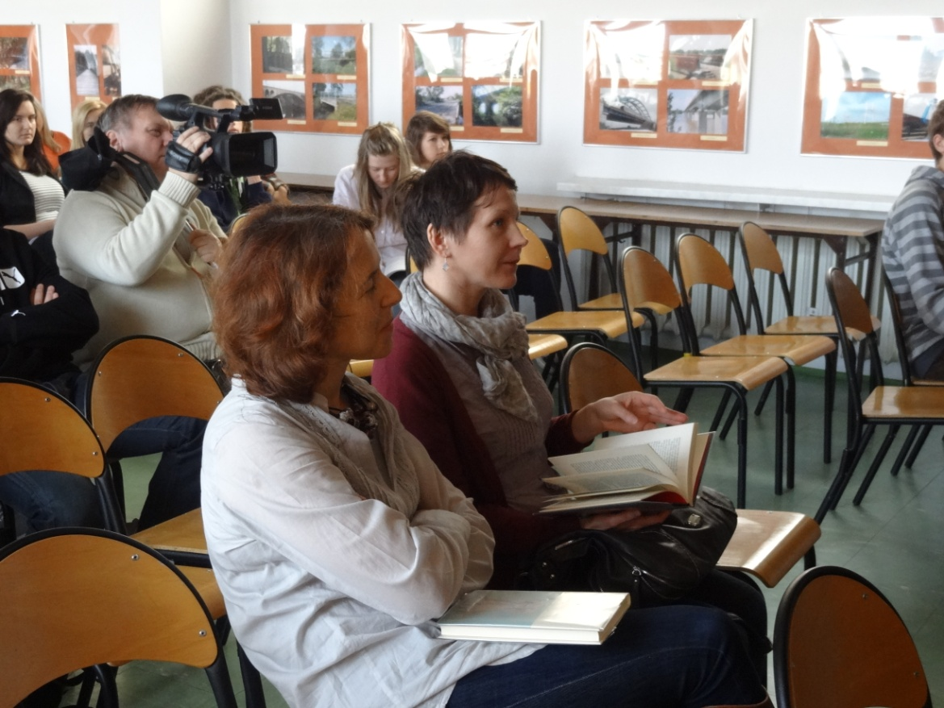
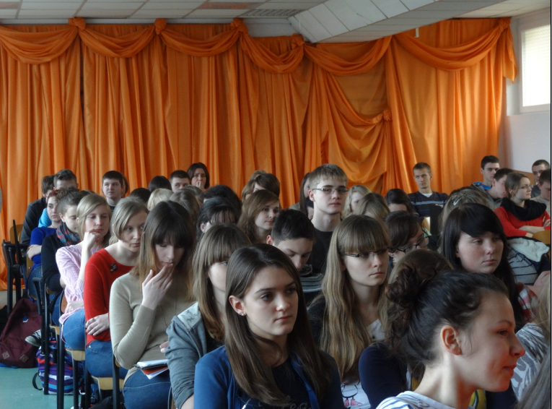
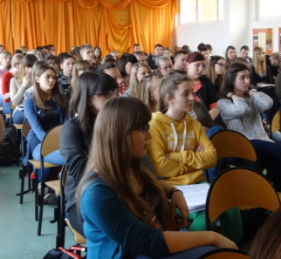
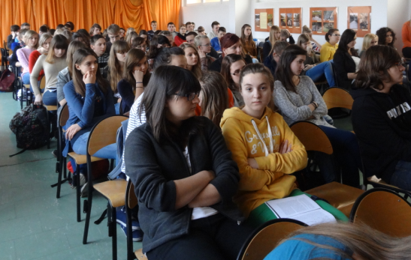

Slide 19
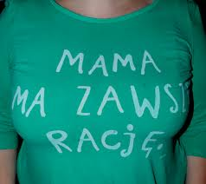
After the meeting writer gave autographs for the attendees.

Slide 20
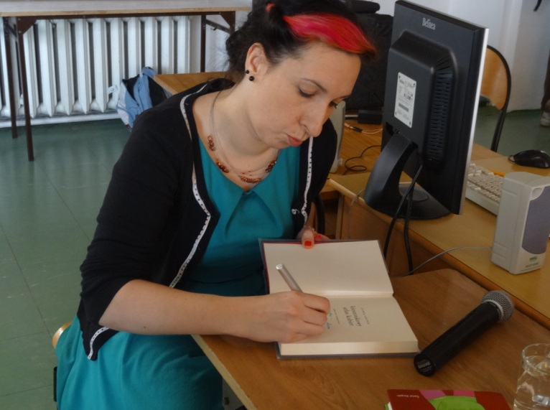

Slide 21
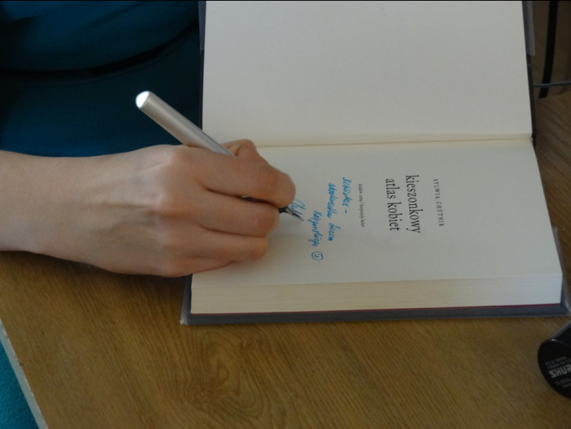

Slide 22
Thank you for your attention
Aleksandra Skrzypczyńska, Aneta Nicowska
uczennice LO im. S. Żeromskiego w Żyrardowie

